Slide 1
High sustained virological response rates using generic direct antiviral treatment for Hepatitis C
REDEMPTION-1
James Freeman¹, Richard Sallie², Adam Kennedy³, Pham Thi Ngoc Nieu¹, John Freeman⁴, Greg Jeffreys⁵, Andrew M. Hill⁶
¹GP2U Telehealth, Hobart, ²Hepatology, Nedlands, ³Kingswood Pharmacy, ⁴Nephrology, Sandy Bay, ⁵University of Tasmania, Hobart, Australia, ⁶St Stephens AIDS Trust, Chelsea and Westminster Hospital, London, United Kingdom
International Liver Congress 2016 13-18 April, Barcelona, Spain
LB03
Notes:
REDEMPTION-1 is an ongoing open label study assessing the safety and effectiveness of generic direct acting antiviral Hepatitis C medication. This is an interim analysis of all the results to date.

Slide 2
A Global Tragedy
In a breakthrough that rivals the invention of penicillin drugs called Direct Acting Antivirals (DAAs), which cure the Hepatitis C Virus (HCV) with minimal side effects and a 95% success rate, have reached the market
Together with HIV, HBV, TB and Malaria, HCV is one of the 5 major causes of infectious disease death worldwide
Tragically this new cure is not being deployed:
We have 150,000,000 infected with HCV worldwide¹, and
We have 500,000 deaths from HCV annually¹, but
We have only 500,000 patients treated for HCV with DAAs annually^{2,3}
http://www.who.int/mediacentre/factsheets/fs164/en/
http://www.unitaid.eu/images/marketdynamics/publications/Hepatitis_C_Medicines_Technology_and_Market_Landscape__Update.pdf
http://www.bidnessetc.com/59228-gilead-sciences-inc-abbvie-inc-finally-see-growth-in-hcv-prescription-volum/
Notes:
Hepatitis C, Hepatitis B, HIV, TB and Malaria are the 5 major causes of infectious disease death worldwide.
In a breakthrough that rivals the invention of penicillin, drugs that cure hepatitis C, with minimal side effects and high success rates, have reached the market.
Across the world 150 million people are infected with Hepatitis C and it causes over ½ a million deaths each year, but, in what must be one of the greatest tragedies of modern times, these life saving medications are not being deployed on a mass scale.
It is sobering to reflect that more patients died last year than received the new treatments.

Slide 3
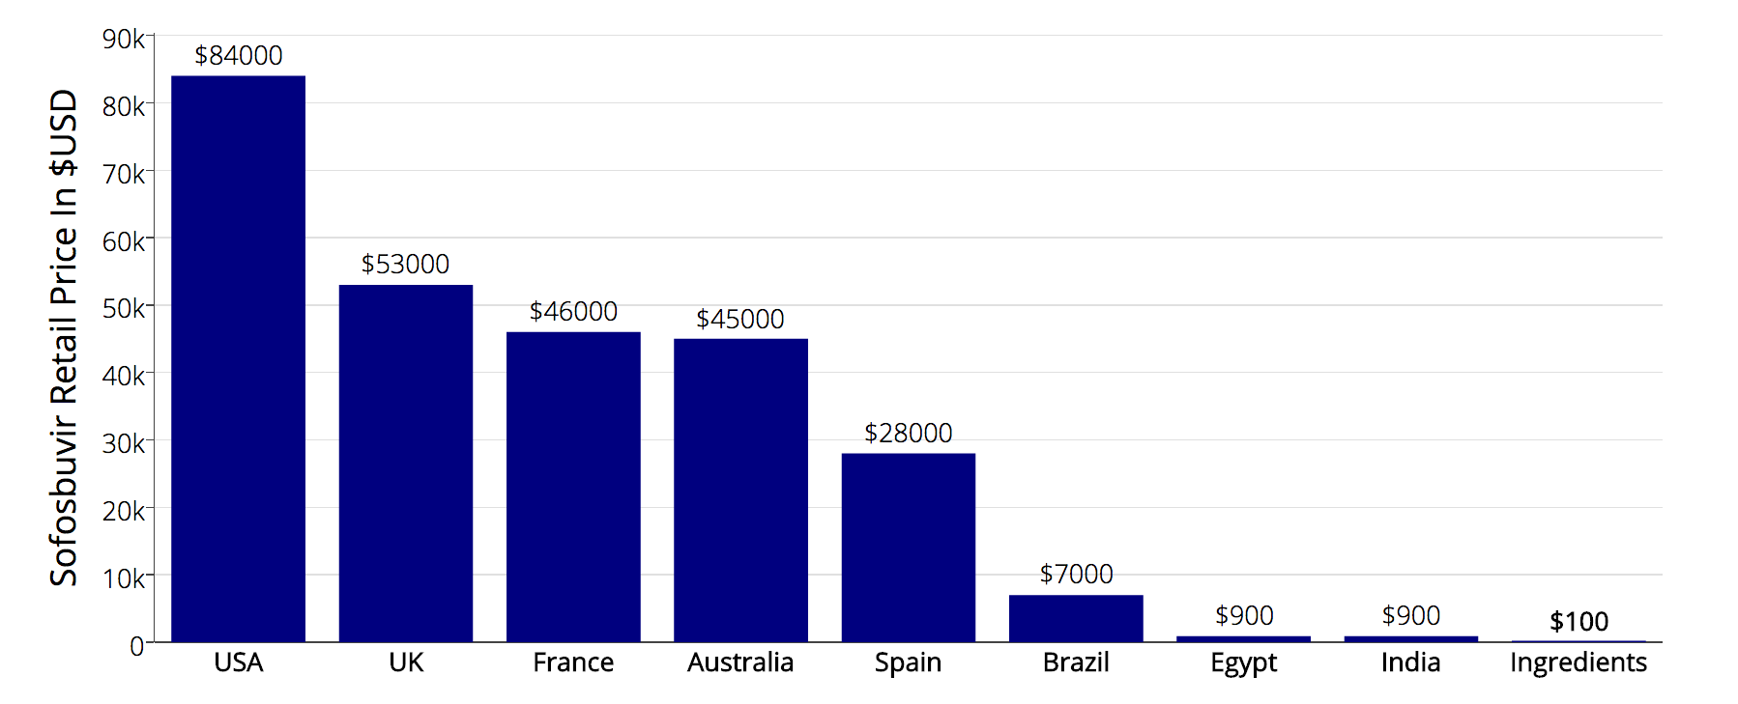
The Deployment Problem Is Price
Source: Significant reductions in costs of generic production of sofosbuvir and daclatasvir for treatment of hepatitis C, Hill et al, EASL 2016
Notes:
The deployment problem is price.
Although the ingredients for a 12 week course of Sovaldi cost less than $100, the US retail price is a staggering $84,000
To put that price in perspective if Apple put the same 100,000% markup on a new iPhone it would cost $1 million dollars.

Slide 4
Background
The high prices of these new medications prevent patient access to highly effective HCV treatment
Generic versions of the DAAs sofosbuvir, ledipasvir, daclatasvir are being mass produced for 1% of the current US retail price¹
Under the laws of Australia², the UK³, and many other countries, individuals have the right to import a three month supply of medication, for their personal use
Hill A. Minimum Costs for Producing Hepatitis C Direct-Acting Antivirals. Clin Inf Dis. 2014
https://www.tga.gov.au/personal-importation-scheme
https://www.gov.uk/government/organisations/hm-revenue-customs
Notes:
So the staggering prices of these new medications prevent patient access to safe and highly effective treatment.
But… Generic versions are being mass produced for under 1% of the current US retail price, in countries where the patents have been rejected.
And… Under the laws of Australia, the UK, and many other countries, individuals have the right to import a three month supply of medication, for their personal use

Slide 5
The Legal Basis Of Personal Importation
Patents provision monopoly rights, however…
Article 60 of TRIPS - De Minimis Imports – states:
Members may exclude from the application of the above provisions small quantities of goods of a non-commercial nature contained in travellers' personal luggage or sent in small consignments
In line with Article 60 most countries allow some form of personal medication importation
http://fixhepc.com/ helps patients access medication and discuss their treatment online
Notes:
Patents provision monopoly rights that are open to abuse, however other laws provision other rights.
Article 60 of the World Trade Organization TRIPS agreement makes small consignments exempt, and in line with Article 60 most countries allow some form of personal medication importation.
The fixhepc website was set up to help patients safely access generic medication and the forum there has over 1000 patients discussing their generic treatment experiences in real time.

Slide 6
Methods
Generic DAAs were first evaluated for quality using HPLC, NMR and Mass Spectrometry
Consecutive patients enrolled via the fixhepc.com website and were assisted in making a personal importation of affordably priced medication
Patients were assessed pre-treatment, during treatment, and then for SVR (cure) following treatment using the gp2u.com.au Telemedicine platform
The objective of this analysis was to assess the safety and effectiveness of the generic medications legally imported by patients
Notes:
When the first patient asked for help, stating he was going to import generics with or without me, I concluded I could improve his safety if the medications he sourced were shipped to me first for testing. The deal was if they passed testing he could take them, and if not they were going in the garbage. The medications tested correctly, the patient took them, and he’s now past SVR24 and cured.
That single patient might have been my only patient, but the news leaked and 1 became a dozen, who in turn became hundreds. Thus was born REDEMPTION.
Consecutive patients were enrolled and assessed pre-treatment, during treatment and then for SVR
The objective was to answer the two key clinical questions – do generics work? and are they safe?

Slide 7
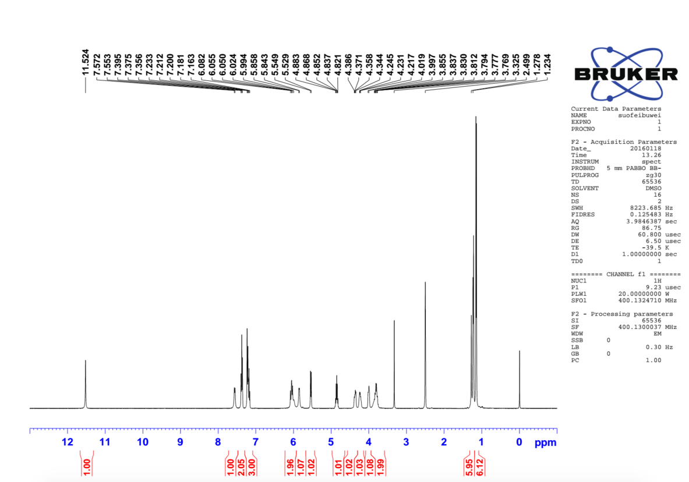
Sofosbuvir NMR
Notes:
For interest here is an NMR spectrum of some generic sofosbuvir. NMR is one of a range of techniques, such as High Performance Liquid Chromatography, Mass Spectrometry and X-ray crystallography that can establish the precise nature and purity of a medication.

Slide 8
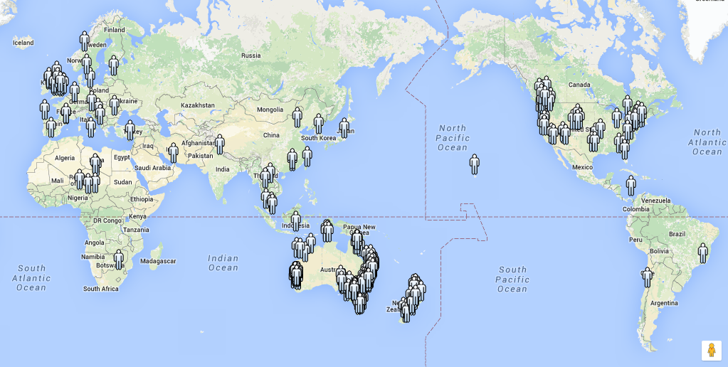
Over 400 Patients Worldwide Enrolled
Notes:
Although REDEMPTION is based in Australia the gp2u Telemedicine platform allowed patients from around the world to enroll

Slide 9
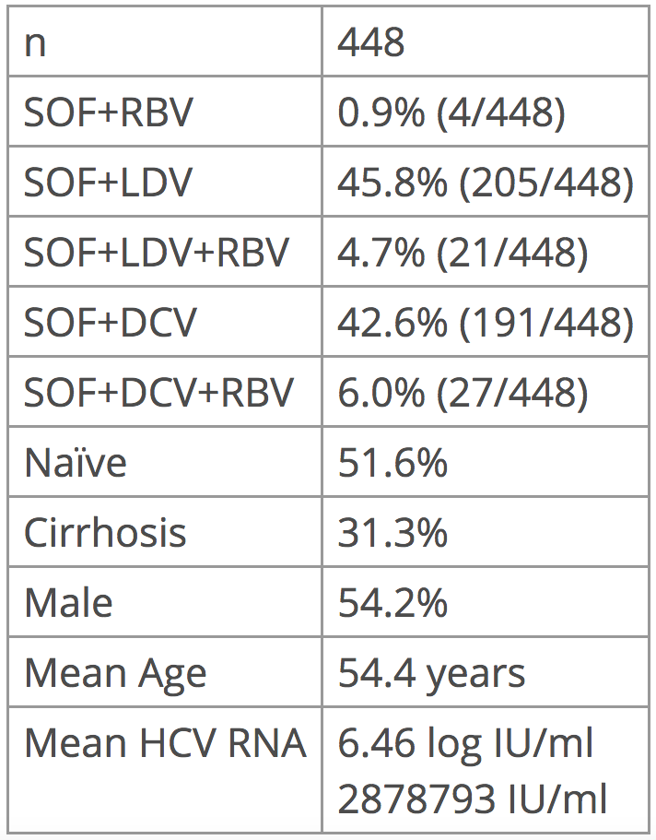
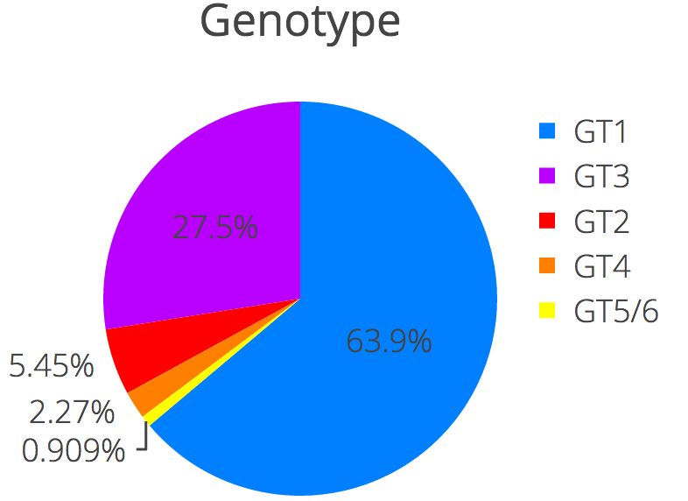
Baseline Characteristics
Notes:
On the right you can see the genotype breakdown with the majority genotype 1, just under 1/3 genotype 3 with smaller percentages of the other genotypes.
448 patients enrolled.
There is a roughly 50:50 split between SOF+LDV and SOF+DCV with just over 10% also using ribavirin
This is a relatively unwell cohort with nearly 50% treatment experienced, over 30% cirrhotic, and a significant number who had previously been rejected from at least one clinical trial.
There was a slight male bias, an average age of 54 and a mean viral load of 2.8 million

Slide 10
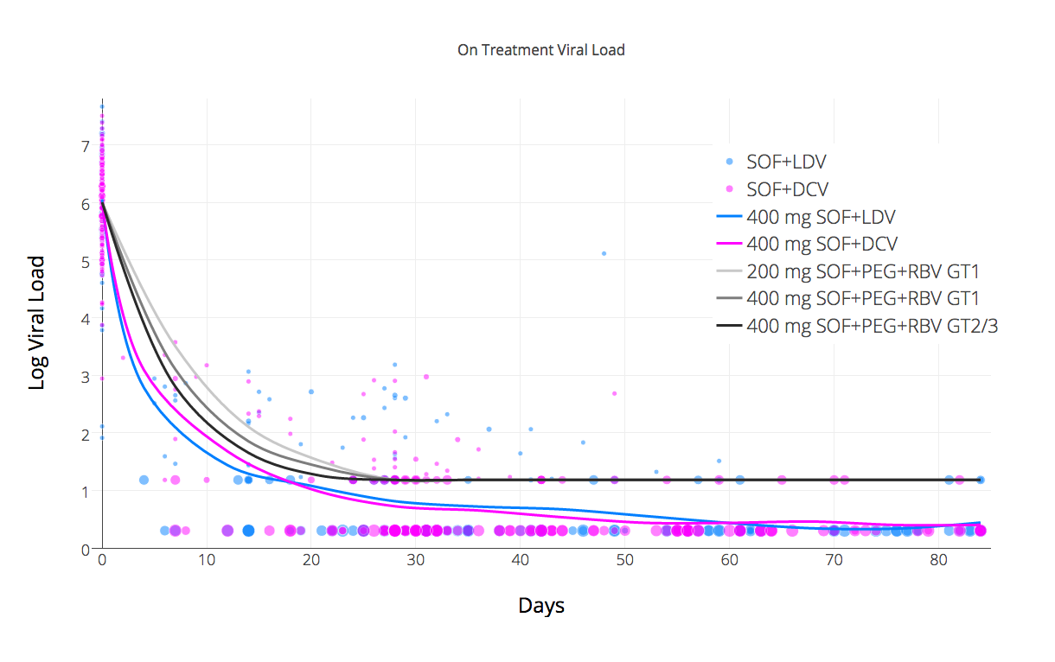
Viral Response REDEMPTION-1 vs Published
SOF+PEG+RBV kinetics data source: http://www.thelancet.com/journals/laninf/article/PIIS1473-3099(13)70033-1/fulltext
Notes:
Let’s look at the on treatment viral kinetics The scatter plot dots are the viral load at various time points, and the size represents the log number of patients. Blue is Ledipasvir and Pink is Daclatasvir.
Unlike the usual reporting which stops at < LLOQ (<15) we have differentiated < LLOD as another data point and I think this makes evident a 2 stage kinetic decay – the first stage is rapid, but the second is substantially slower and it’s this slower second stage that dictates the minimum treatment duration.
The 3 grey lines are from data published in the Lancet in 2014 about the on treatment kinetics for SOF+PEG+RBV. As you can see the response for both the generic combinations used was substantially faster than this demonstrating the impact of effective NS5A inhibition. The difference between the SOF+LDV and SOF+DCV kinetics, where Daclatasvir looks slower, is an artifact due to it’s higher use in GT3 where the kinetics are slower than in GT1. If we look only at GT1 with SOF+DCV we see the response is slightly better that SOF+DCV and it crosses <LLOQ a little earlier.
There was one virological breakthrough.

Slide 11
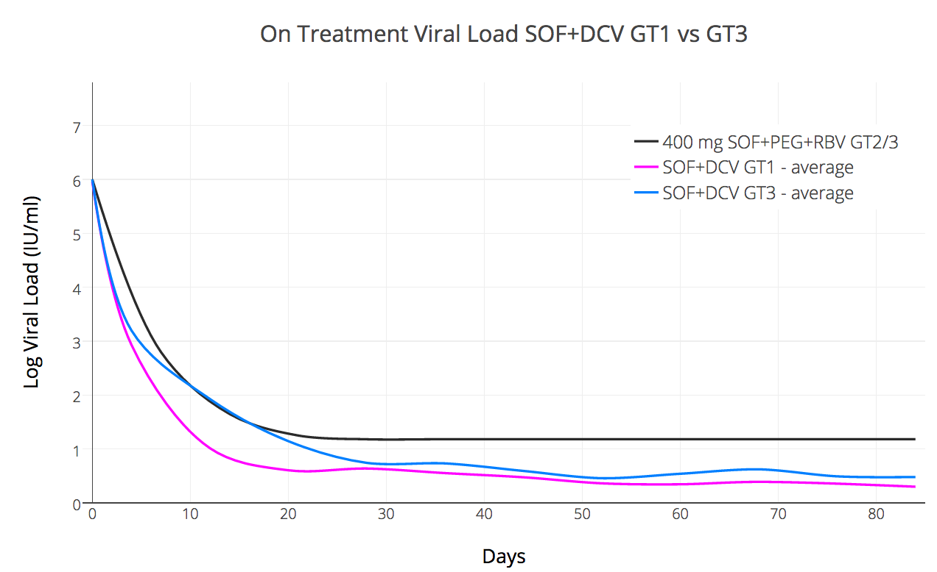
SOF+DCV Kinetics GT1 vs GT3
Notes:
We used SOF+DCV in both GT1 and GT3 patients. We also differentiated <LLOQ (<15) and <LLOD (undetected)
What this allows us to see is that the kinetics in GT1 are prompt and essentially all patients are undetected by day 55 giving a notional 30 day over treat.
This is not the case with GT3 where the kinetics suggest 16 weeks treatment (or perhaps even longer) should really be the default minimum (or that for 12 weeks Ribavirin should be regarded as essential)

Slide 12
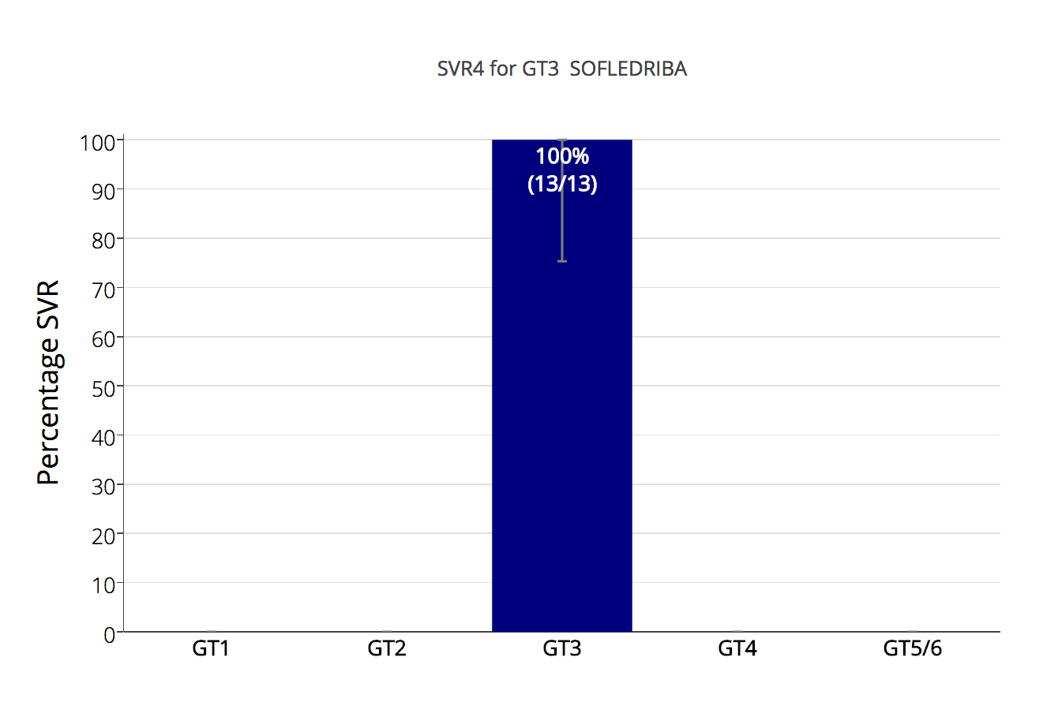
SOF+LDV+RBV for GT3? (Ed Gane 2015¹)
1) http://www.ncbi.nlm.nih.gov/pubmed/26261007
Notes:
So now to the first of the results.
In 2015 Professor Ed Gane published an interesting study about the use of SOF+LDV+/-RBV in GT3
One group – treatment naïve patients who also had RBV did very well with a 100% (26/26) SVR rate.
We’ve duplicated that result with generics suggesting it is repeatable and should perhaps be investigated at a larger scale.

Slide 13
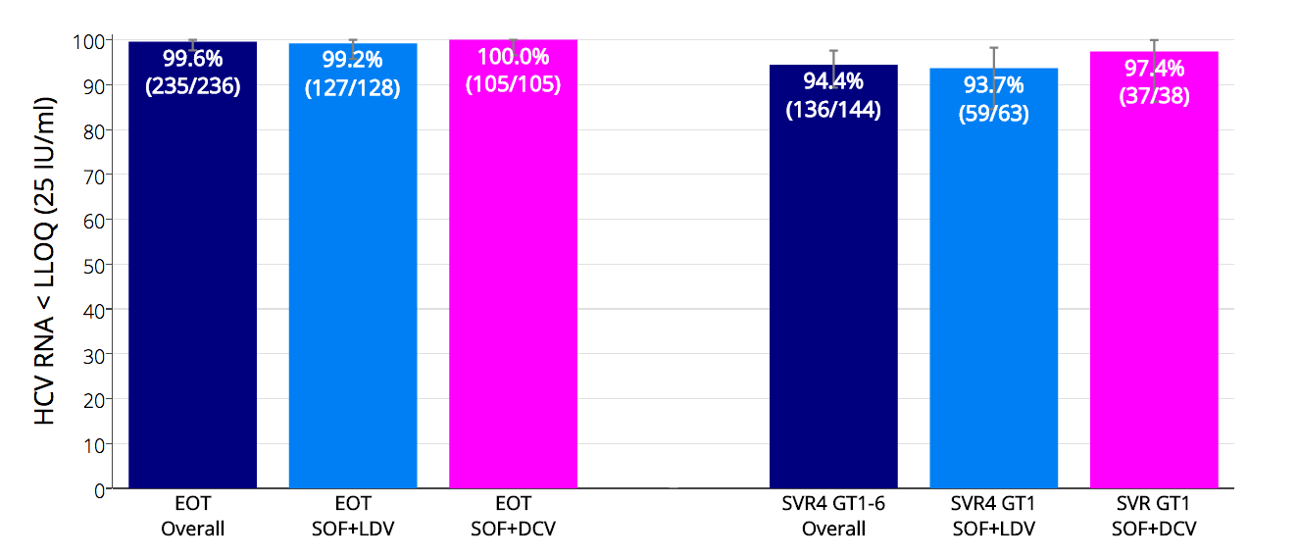
REDEMPTION-1 HCV RNA < LLOQ at EOT and SVR4
Notes:
Here we can see that at the end of treatment 99.6% of patients were <LLOQ. One virological breakthrough reduced the result for LDV
The overall SVR4 rate was 94.4%.
Looking at GT1 only the results of LDV and DCV were similar, with the LDV result again suffering from that breakthrough patient (S282T RAV)

Slide 14
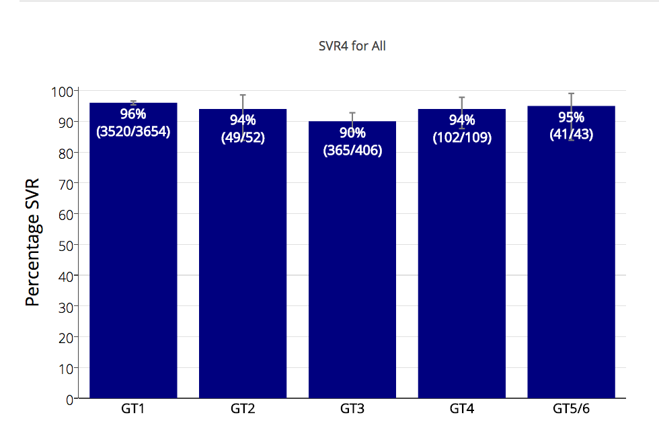
Published SVR12 Results SOF+LDV and SOF+DCV
Notes:
Dr Andrew Hill aggregated all the clinical trials data we could find for the DAA combinations SOF+LDV and SOF+DCV, and they are presented here.
And if we compare this to the results of generics….

Slide 15
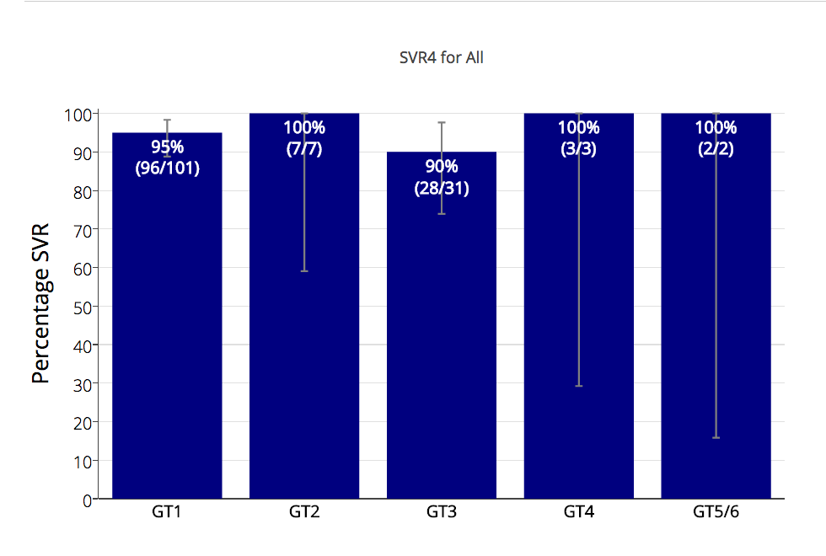
REDEMPTION-1 Overall SVR4 Results For Generics
Note: Some small percentage loss of SVR is expected during the SVR4 to SVR12 period
Notes:
We don’t see a lot of difference.
The 100% results in GT2,4,5,6 are of course pretty meaningless given the tiny numbers, but for GT1 and GT3 the results are in line with expectations.
We do expect a handful of patients who passed SVR4 to fail SVR12 but don’t expect that to cause a huge change and note the confidence intervals are already reasonably narrow.

Slide 16
Patient Safety
No new or unknown side effects were reported with headache, fatigue and insomnia being the most common
3 patients with compensated cirrhosis temporarily decompensated on treatment initiation but continued
4 patients who enrolled died, all from HCC
1 patient died prior to treatment commencement
2 withdrew early in treatment and entered palliative care
1 patient died prior to SVR4
Notes:
No new or unknown side effects were reported with headache, fatigue and insomnia being the most common
3 patients with compensated cirrhosis temporarily decompensated on treatment initiation but continued with treatment
4 patients who enrolled have since died, all from HCC

Slide 17
Summary
In this interim analysis, treatment with legally imported generic DAAs led to high SVR rates
These SVR rates are similar to those seen in the Phase 3 trials of branded treatments
Mass global treatment with generic DAAs is a feasible alternative where high prices prevent access to branded treatment
Notes:
So in this interim analysis treatment with legally imported generic DAAs produced similar SVR rates to what we would expect from the clinical trials of their branded counterparts.
Doctors prescribing and monitoring patients taking generics can take comfort from the fact that, like the HIV generics that came before them, HCV generics deliver robust clinical results.

Slide 18
Conclusions
Generic cure for Hepatitis C is available now for $1000 and works as expected
Given current API pricing and production costs $200/patient treatment with SOF+DCV is possible, not in the future, but right now¹
Without treatment the future for millions of patients infected with HCV looks like this…
Hill A. Minimum Costs for Producing Hepatitis C Direct-Acting Antivirals. Clin Inf Dis. 2014
Notes:
Generic cure for Hepatitis C is available now for $1000 and works as expected
Given current API pricing and production costs $200/patient treatment with SOF+DCV is possible, not in the future, but right now
It’s sad to reflect that at a price of $200/patient the entire world – all 150 million patients - could have been treated for less than the $31.5 billion dollars in profits made from the Sovaldi franchise in the last 3 years.
Without treatment the future for millions of patients infected with HCV looks like this…

Slide 19
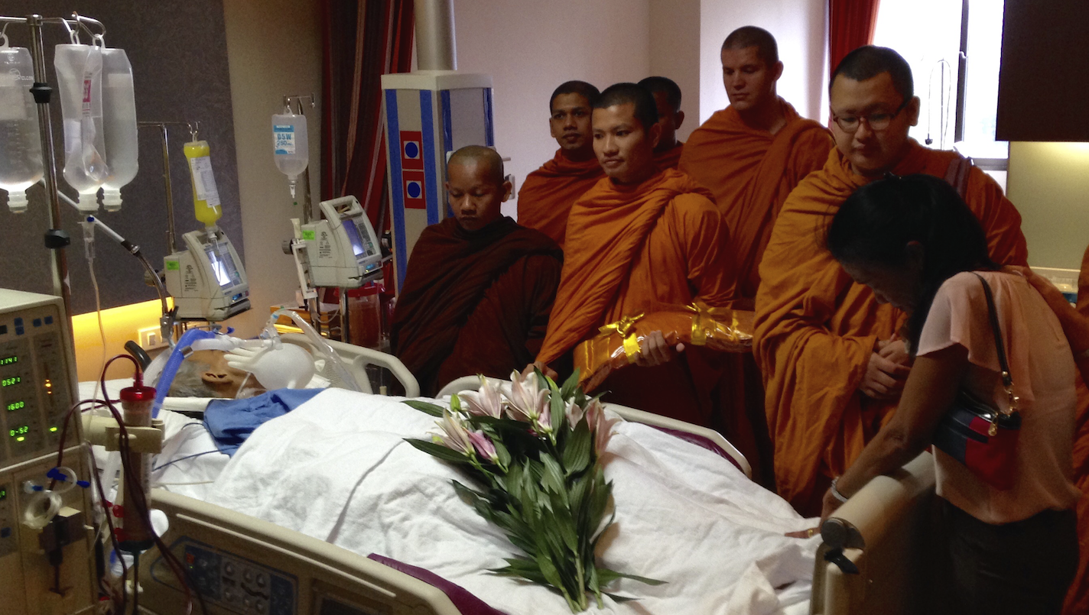
Notes:
RIP

Slide 20
Notes:
In the time it took to give this presentation another 15 of our fellow citizens perished from a disease we have the power to cure.
We have the power to FixHepC.
My question to you, the audience, is do we have the will power? The will power to think global, but act local, and see cure deployed on a mass scale?
….Or would we rather blindly protect patent rights at the expense of patient lives?
Generics work. Let’s deploy them and wipe Hepatitis C off the face of the planet like we’ve done with smallpox and polio.

Slide 21
More Information
http://fixhepc.com
https://gp2u.com.au
https://clinicaltrials.gov/ct2/show/NCT02657694
HCV Decision Support Tool with expected SVR https://gp2u.com.au/hcv
Notes:
Questions?

