Slide 1
使用丙肝学名药（高治愈率）
REDEMPTION-1 (救赎-1)丙肝学名药实验结果
James Freeman¹, Richard Sallie², Adam Kennedy³, Pham Thi Ngoc Nieu¹, John Freeman⁴, Greg Jeffreys⁵, Andrew M. Hill⁶
¹GP2U Telehealth, Hobart, ²Hepatology, Nedlands, ³Kingswood Pharmacy, ⁴Nephrology, Sandy Bay, ⁵University of Tasmania, Hobart, Australia, ⁶St Stephens AIDS Trust, Chelsea and Westminster Hospital, London, United Kingdom
国际肝病２０１６研讨会，巴塞罗那（西班牙）
International Liver Congress 2016 13-18 April, Barcelona, Spain
LB03
Notes:
REDEMPTION-1 is an ongoing open label study assessing the safety and effectiveness of generic direct acting antiviral Hepatitis C medication. This is an interim analysis of all the results to date. （Redemption-1这项实验的目的是探讨丙肝学名药的安全性及有效性）。

Slide 2
丙肝：环球悲剧
市场上已推出低副作用与高治愈率的丙肝学名药。
丙肝 - 世界五大传染病之一
很不幸的，新药并没有得到广泛使用
全球有一亿五千万人受感染
有五十万人死于丙肝，但是
^{_只有五十万人接受新的药物治疗}
Notes:
Hepatitis C, Hepatitis B, HIV, TB and Malaria are the 5 major causes of infectious disease death worldwide.
In a breakthrough that rivals the invention of penicillin, drugs that cure hepatitis C, with minimal side effects and high success rates, have reached the market.
Across the world 150 million people are infected with Hepatitis C and it causes over ½ a million deaths each year, but, in what must be one of the greatest tragedies of modern times, these life saving medications are not being deployed on a mass scale.
It is sobering to reflect that more patients died last year than received the new treatments.

Slide 3
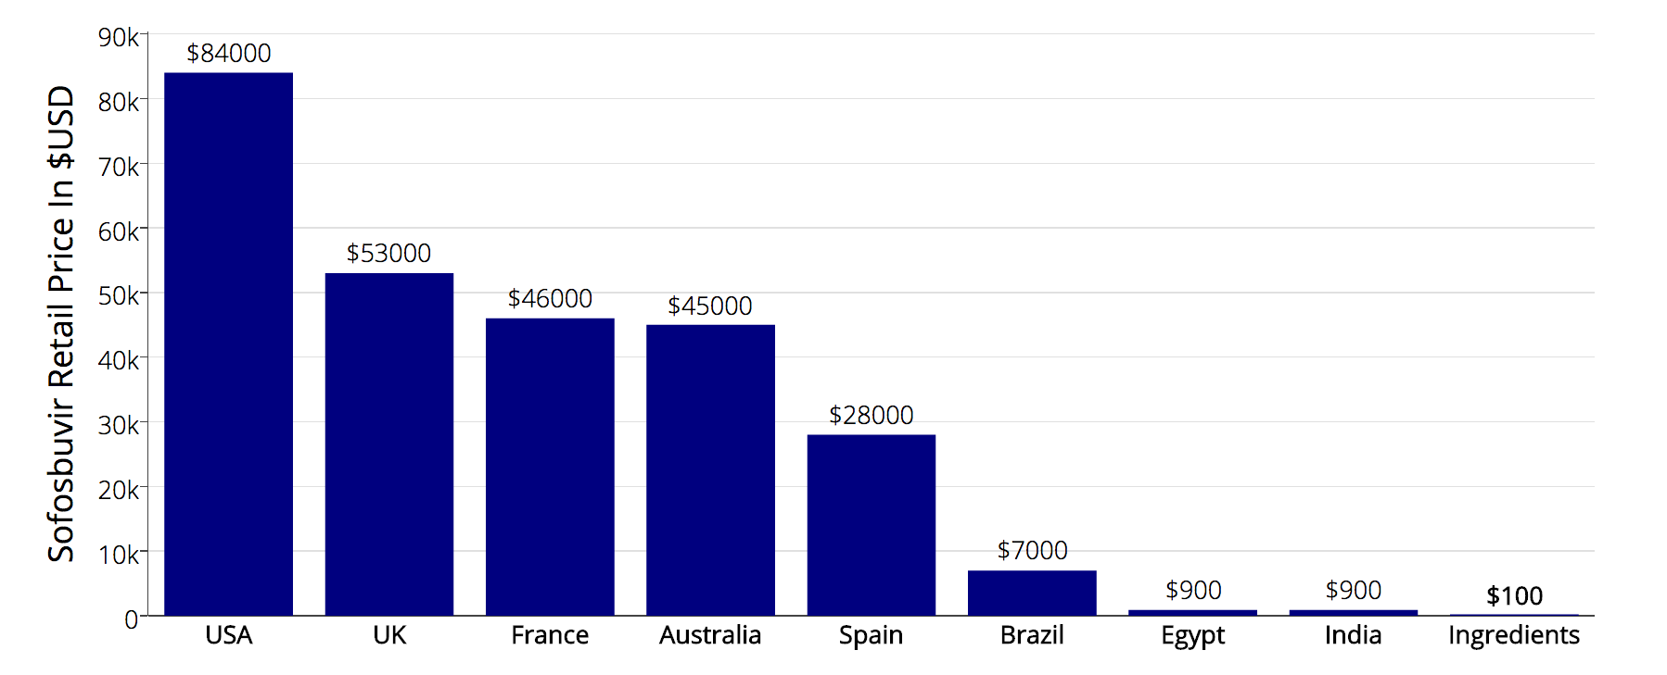
不被使用原因：药物太昂贵
Source: Significant reductions in costs of generic production of sofosbuvir and daclatasvir for treatment of hepatitis C, Hill et al, EASL 2016
Notes:
The deployment problem is price.
Although the ingredients for a 12 week course of Sovaldi cost less than $100, the US retail price is a staggering $84,000 制造１２周疗程索非布韦的原料价格低于１００美元，但在美国索非布韦的售价却是８４０００美元
To put that price in perspective if Apple put the same 100,000% markup on a new iPhone it would cost $1 million dollars. 如果苹果公司也这样涨价，每台新手机的售价将会是一百万美元（１００，０００八仙涨价）。

Slide 4
背景
药物太昂贵导致病人无法接受安全且有效的治疗。
^{丙肝学名药价钱只占原厂药的百分之一。}
澳大利亚、英国等国家允许个人进口药物（每次进口数量以三个月为限）
Notes:
So the staggering prices of these new medications prevent patient access to safe and highly effective treatment.
But… Generic versions are being mass produced for under 1% of the current US retail price, in countries where the patents have been rejected. 在一些原厂药注册权被驳回的国家，学名药被大量仿制，价格只占原厂药的１八仙。
And… Under the laws of Australia, the UK, and many other countries, individuals have the right to import a three month supply of medication, for their personal use

Slide 5
个人进口药物是合法的
药物公司在已注册原厂药的国家有垄断权，不过，TRIPS 第六十条 - De Minimis Imports – 列出:
不包括少量非商业用途、以个人名义进口、供病人自己服用的学名药。
因此，大多数国家都允许个人进口学名药。
http://fixhepc.com/帮助病人取得学名药，让病人讨论治疗方案。
Notes:
Patents provision monopoly rights that are open to abuse, however other laws provision other rights. 知识产权被药物公司滥用，但仍有其他法律保障病人的权益。
Article 60 of the World Trade Organization TRIPS agreement makes small consignments exempt, and in line with Article 60 most countries allow some form of personal medication importation.
The fixhepc website was set up to help patients safely access generic medication and the forum there has over 1000 patients discussing their generic treatment experiences in real time.

Slide 6
实验方法
fixhepc使用高科技 HPLC, NMR and Mass Spectrometry确保学名药的品质。
帮助已报名的病人进口负担得起的学名药。
利用gp2u.com.au Telemedicine 平台追踪病人的情况（治疗前、治疗时、治疗后）
确保以合法途径进口的学名药有效并且安全。
Notes:
When the first patient asked for help, stating he was going to import generics with or without me, I concluded I could improve his safety if the medications he sourced were shipped to me first for testing. The deal was if they passed testing he could take them, and if not they were going in the garbage. The medications tested correctly, the patient took them, and he’s now past SVR24 and cured. 我帮助了我第一个丙肝病人取得了有效与安全的丙肝学名药（他现在已治愈）。
That single patient might have been my only patient, but the news leaked and 1 became a dozen, who in turn became hundreds. Thus was born REDEMPTION. （消息传出后，由于病人越来越多，我决定进行ＲＥＤＥＭＰＴＩＯＮ实验，证明学名药与原厂药有一样的疗效）。
Consecutive patients were enrolled and assessed pre-treatment, during treatment and then for SVR
The objective was to answer the two key clinical questions – do generics work? and are they safe?

Slide 7
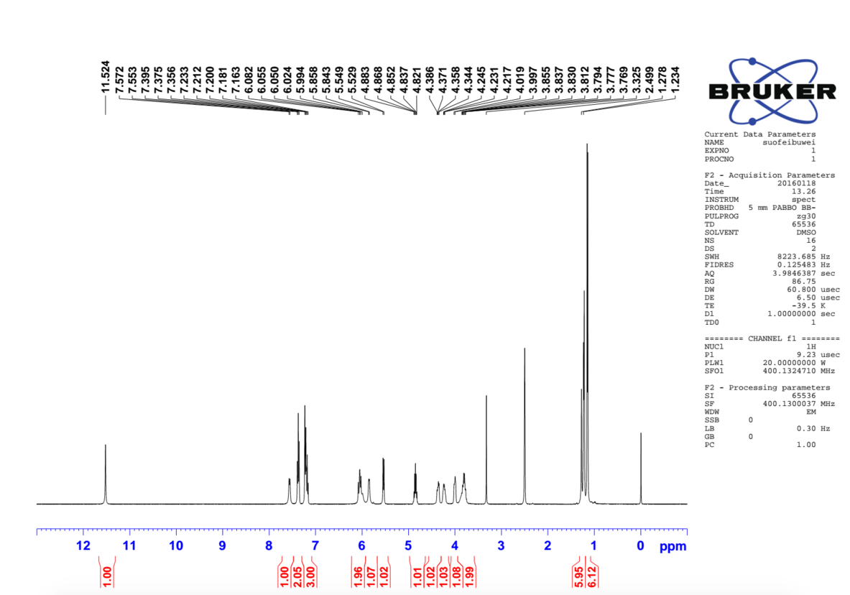
Sofosbuvir NMR
（某Sofobuvir 学名药的化验报告，利用NMR能准确测出药物的纯度）
Notes:
For interest here is an NMR spectrum of some generic sofosbuvir. NMR is one of a range of techniques, such as High Performance Liquid Chromatography,Mass Spectrometry and X-ray crystallography that can establish the precise nature and purity of a medication. （某公司的索菲布韦Sofobuvir 学名药的化验报告，利用NMR能准确测出药物的纯度）

Slide 8
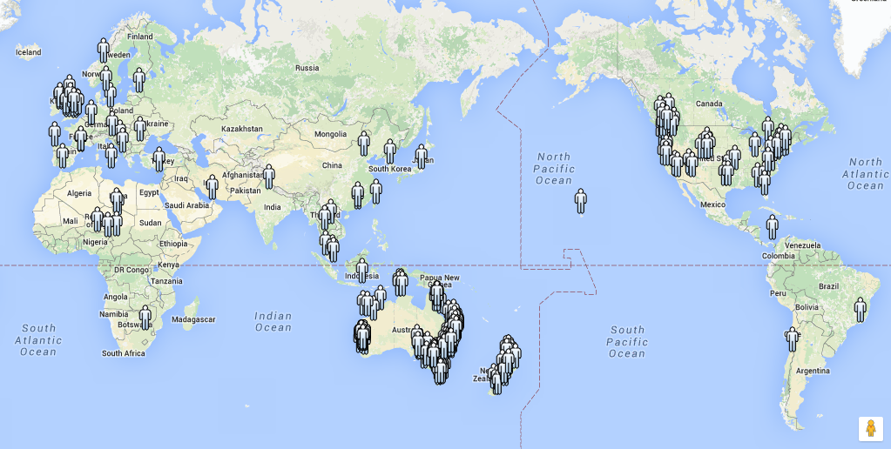
全球超过400人已报名加入REDEMPTION实验
Notes:
Although REDEMPTION is based in Australia the gp2u Telemedicine platform allowed patients from around the world to enroll

Slide 9
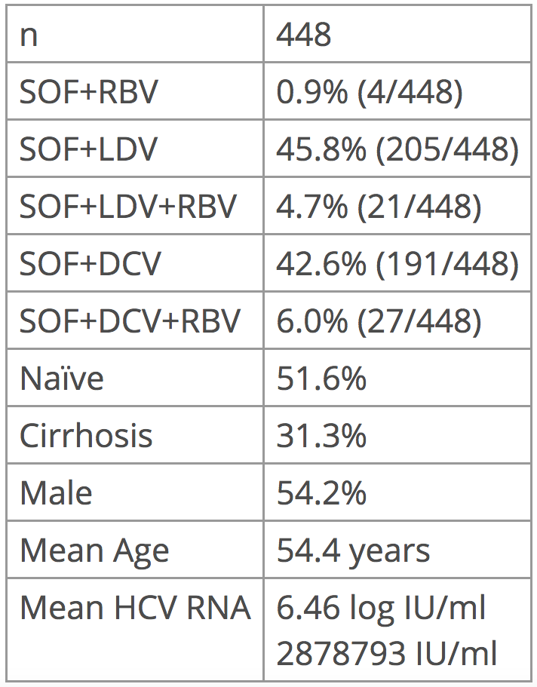
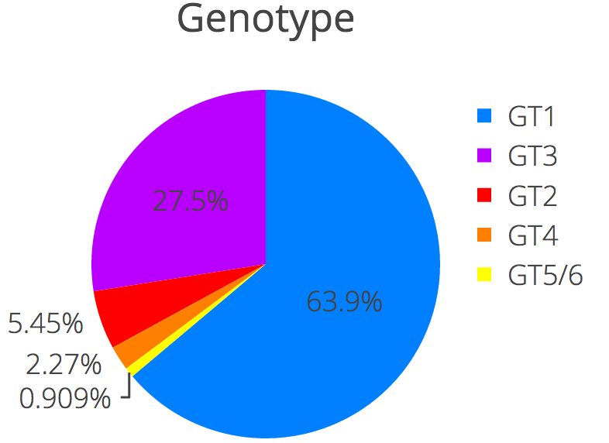
病人特征
实验人数
基因型
未经治疗
肝硬化
男性
ＳＯＦ＝索非布韦
ＬＤＶ＝拉地帕韦（吉二代）
ＤＣＶ＝达卡他韦
ＲＢＶ＝雷巴
平均年龄
平均病毒值
Notes:
On the right you can see the genotype breakdown with the majority genotype 1, just under 1/3 genotype 3 with smaller percentages of the other genotypes.
448 patients enrolled.
There is a roughly 50:50 split between SOF+LDV and SOF+DCV with just over 10% also using ribavirin 一半的病人使用ＳＯＦ＋ＬＤＶ，另一半则用ＳＯＦ＋ＤＣＶ，１０八仙的病人必须使用雷巴。
This is a relatively unwell cohort with nearly 50% treatment experienced, over 30% cirrhotic, and a significant number who had previously been rejected from at least one clinical trial. ５０八仙的病人曾经接受过治疗，３０八仙的病人属肝硬化，有相当多的病人之前申请药物实验至少被拒绝过一次。
There was a slight male bias, an average age of 54 and a mean viral load of 2.8 million

Slide 10
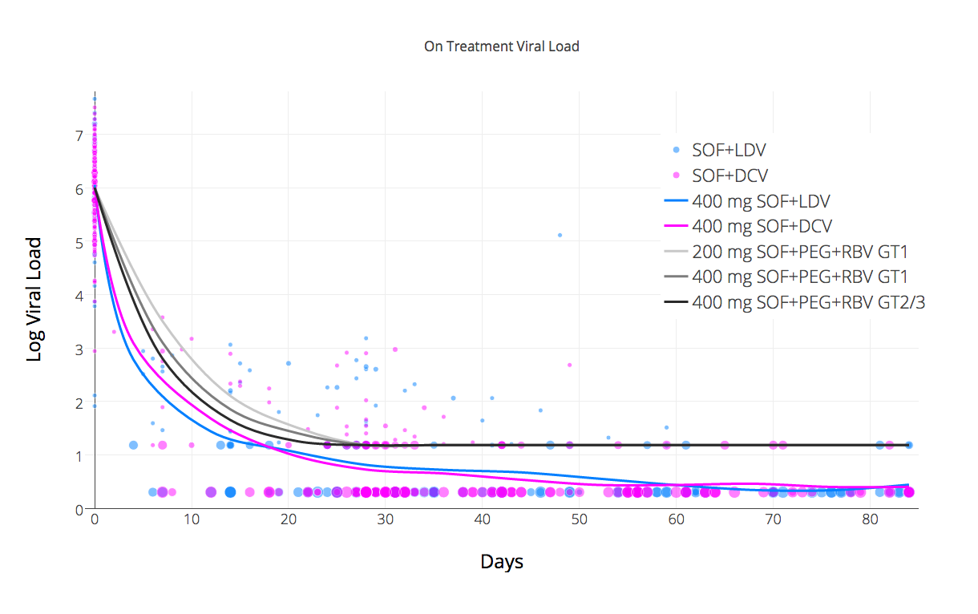
REDEMPTION-1 各基因型对药物的反应
索非布韦+拉地帕韦（吉二代）
索菲布韦+达卡他韦
PEG=干扰素，RBV=雷巴）
SOF+PEG+RBV kinetics data source: http://www.thelancet.com/journals/laninf/article/PIIS1473-3099(13)70033-1/fulltext
Notes:
Let’s look at the on treatment viral kinetics The scatter plot dots are the viral load at various time points, and the size represents the log number of patients. Blue is Ledipasvir and Pink is Daclatasvir. 让我们来看看新学名药对丙肝的反应。蓝色的点代表ＬＤＶ，粉红色代表ＤＣＶ，标志着不同时间病毒值的指数；点的大小表示病人的病毒值）。
Unlike the usual reporting which stops at < LLOQ (<15) we have differentiated < LLOD as another data point and I think this makes evident a 2 stage kinetic decay – the first stage is rapid, but the second is substantially slower and it’s this slower second stage that dictates the minimum treatment duration.
The 3 grey lines are from data published in the Lancet in 2014 about the on treatment kinetics for SOF+PEG+RBV. As you can see the response for both the generic combinations used was substantially faster than this demonstrating the impact of effective NS5A inhibition. 表上的三条灰线代表Lancet 2014 SOF+PEG+ＲＢＶ对丙肝的反应。新的学名药ＬＤＶ和ＤＣＶ比ＳＯＦ＋ＰＥＧ＋ＲＢＶ能更快抑制病毒。The difference between the SOF+LDV and SOF+DCV kinetics, where Daclatasvir looks slower, is an artifact due to it’s higher use in GT3 where the kinetics are slower than in GT1. If we look only at GT1 with SOF+DCV we see the response is slightly better that SOF+DCV and it crosses <LLOQ a little earlier. ＤＣＶ在抑制ＧＴ３反应较慢，在ＧＴ１则较快。
There was one virological breakthrough. 一个病人在接受治疗时，病毒对药物产生抗体。

Slide 11
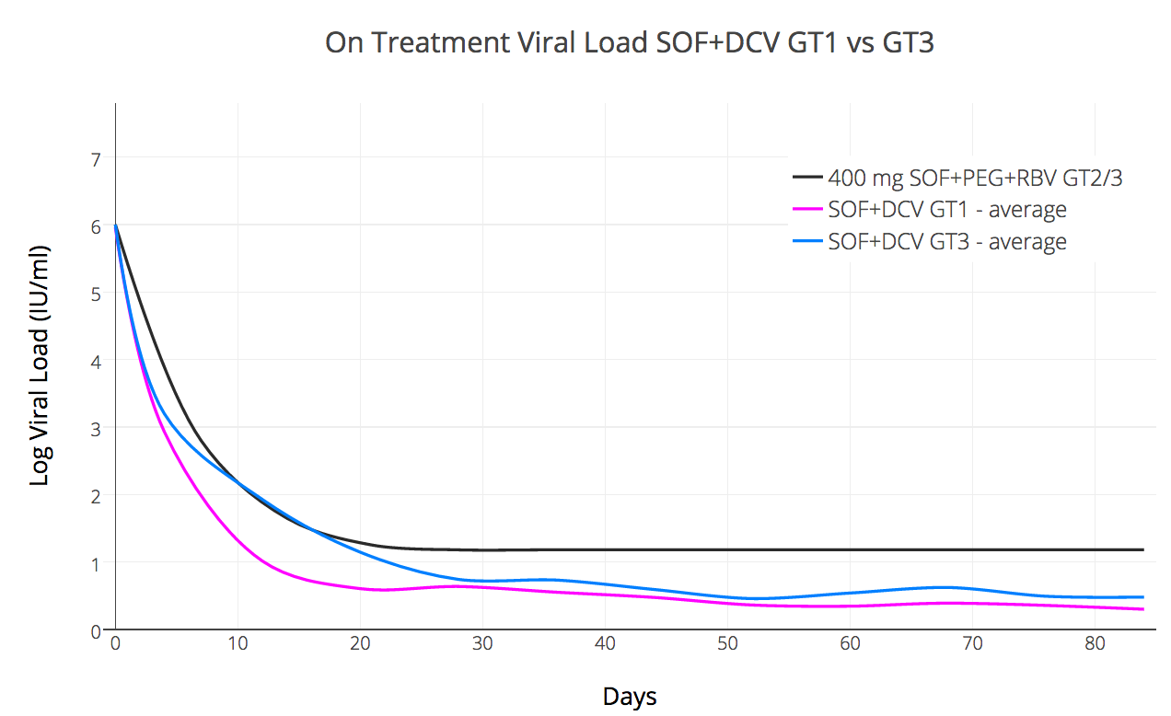
比较SOF+DCV GT1 与 GT3 的反应
Notes:
We used SOF+DCV in both GT1 and GT3 patients. We also differentiated <LLOQ (<15) and <LLOD (undetected)
What this allows us to see is that the kinetics in GT1 are prompt and essentially all patients are undetected by day 55 giving a notional 30 day over treat. （GT1大多数病人服用12周已足够）。
This is not the case with GT3 where the kinetics suggest 16 weeks treatment (or perhaps even longer) should really be the default minimum (or that for 12 weeks Ribavirin should be regarded as essential) （GT3我们建议使用16周以上；12周应加雷巴）。

Slide 12
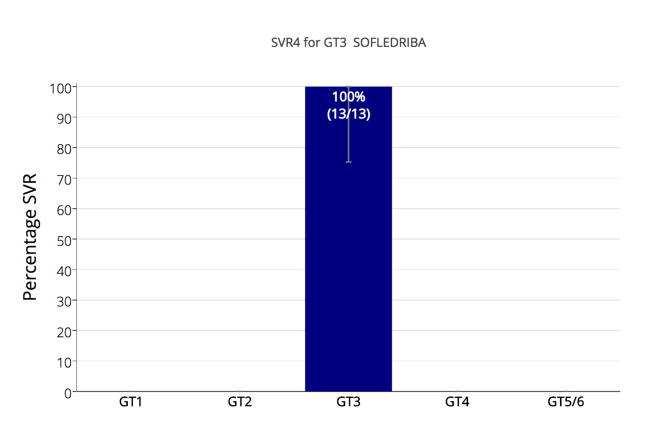
SOF+LDV+RBV 适用于GT3? (Ed Gane 2015¹)
1) http://www.ncbi.nlm.nih.gov/pubmed/26261007
Notes:
So now to the first of the results.
In 2015 Professor Ed Gane published an interesting study about the use of SOF+LDV+/-RBV in GT3 (Redemption-1使用SOF+LDV+RBV对基因型3的反应与原厂药相似 （Ｅｄ Ｇａｎｅ ２０１５ ）。
One group – treatment naïve patients who also had RBV did very well with a 100% (26/26) SVR rate.从未接受治疗的病人使用雷巴时，治愈率达100八仙。
We’ve duplicated that result with generics suggesting it is repeatable and should perhaps be investigated at a larger scale.

Slide 13
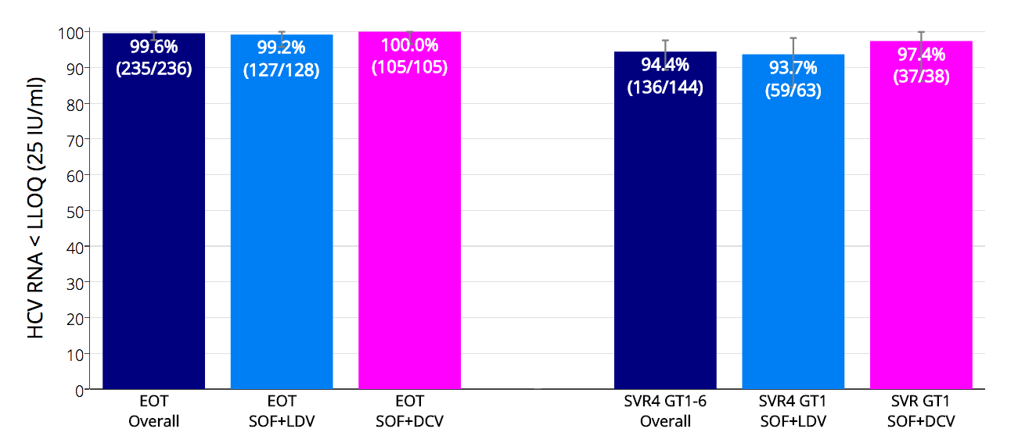
REDEMPTION-1 HCV RNA < LLOQ at EOT and SVR4 完成治疗（EOT）与治疗后四周（SVR）检测不到病毒值的比率）
完成治疗总体表现
治疗后四周的总体表现
Notes:
Here we can see that at the end of treatment 99.6% of patients were <LLOQ. One virological breakthrough reduced the result for LDV
The overall SVR4 rate was 94.4%. 治疗四周后总治愈率：94.4八仙。
Looking at GT1 only the results of LDV and DCV were similar, with the LDV result again suffering from that breakthrough patient (S282T RAV) 在治疗GT1时。拉地帕韦与达卡他韦的治愈率相似；一个病人在使用拉地帕韦时病毒反弹，影响了拉地帕韦的总治愈率。

Slide 14
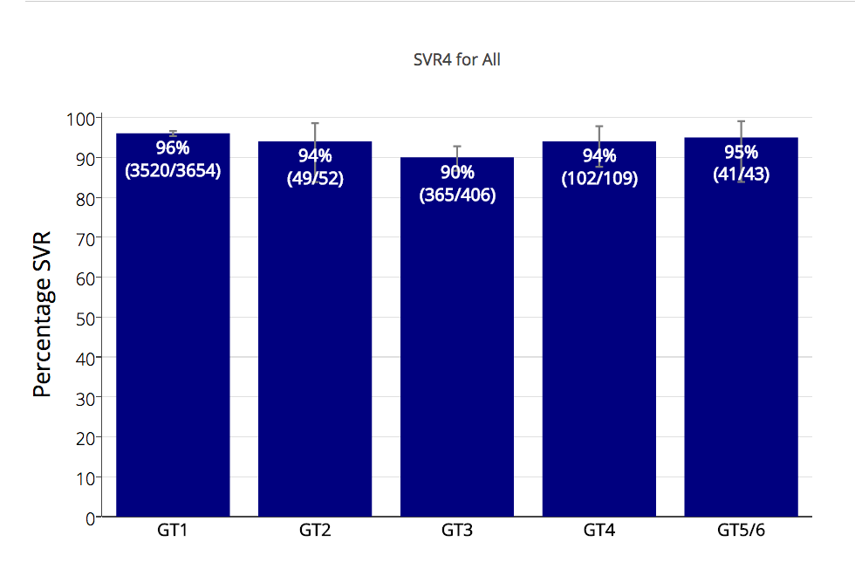
SOF+LDV 与 SOF+DCV 原厂药治疗后12周治愈率……
Notes:
Dr Andrew Hill aggregated all the clinical trials data we could find for the DAA combinations SOF+LDV and SOF+DCV, and they are presented here.
And if we compare this to the results of generics….

Slide 15
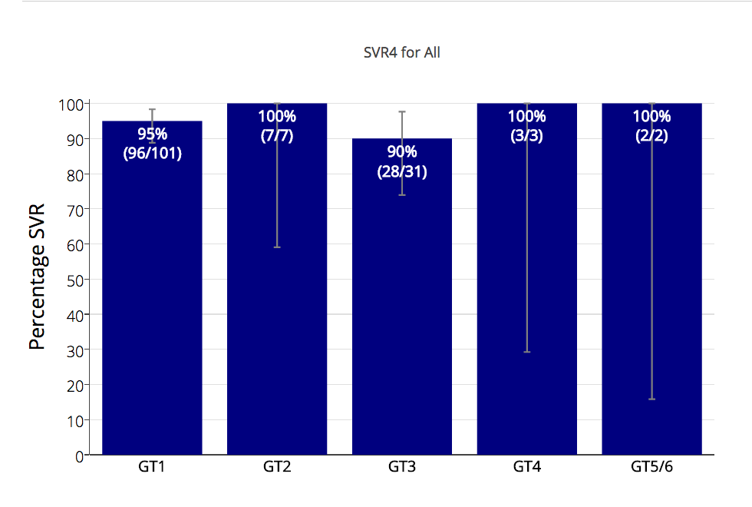
……与学名药的治愈率（治疗后四周） 没有太大的区别
Note: Some small percentage loss of SVR is expected during the SVR4 to SVR12 period
Notes:
We don’t see a lot of difference.
The 100% results in GT2,4,5,6 are of course pretty meaningless given the tiny numbers, but for GT1 and GT3 the results are in line with expectations.
We do expect a handful of patients who passed SVR4 to fail SVR12 but don’t expect that to cause a huge change and note the confidence intervals are already reasonably narrow. 少数病人可能在治疗后12周复发，但对治愈率不会有太大的变化。

Slide 16
药物的安全性
实验结果显示没有新的副作用，与原厂药相似（头疼、疲倦与失眠）
三个肝硬化病人治疗后变临时性失偿，但仍继续使用学名药）
四个病人死于肝癌
一个治疗前已去世
两个在接受治疗不久后就退出，并接受临终治疗。
一个在治疗后4周前去世。
Notes:
No new or unknown side effects were reported with headache, fatigue and insomnia being the most common
3 patients with compensated cirrhosis temporarily decompensated on treatment initiation but continued with treatment
4 patients who enrolled have since died, all from HCC

Slide 17
总结
合法进口的学名药拥有很高的治愈率。
学名药治愈率与原厂药相似。
学名药能有效取代昂贵的原厂药。
Notes:
So in this interim analysis treatment with legally imported generic DAAs produced similar SVR rates to what we would expect from the clinical trials of their branded counterparts.
Doctors prescribing and monitoring patients taking generics can take comfort from the fact that, like the HIV generics that came before them, HCV generics deliver robust clinical results.

Slide 18
总结
丙肝学名药只需1000元而且有效。
^{ＳＯＦ＋ＤＣＶ的原料价格与生产价格只需}
^{２００元。}
无法接受治疗的病人可能会面临这样的后果……
Notes:
Generic cure for Hepatitis C is available now for $1000 and works as expected
Given current API pricing and production costs $200/patient treatment with SOF+DCV is possible, not in the future, but right now
It’s sad to reflect that at a price of $200/patient the entire world – all 150 million patients - could have been treated for less than the $31.5 billion dollars in profits made from the Sovaldi franchise in the last 3 years. 很遗憾的，原厂药3年的利润能供全球一亿五千万的丙肝病人接受治疗。
Without treatment the future for millions of patients infected with HCV looks like this…

Slide 19
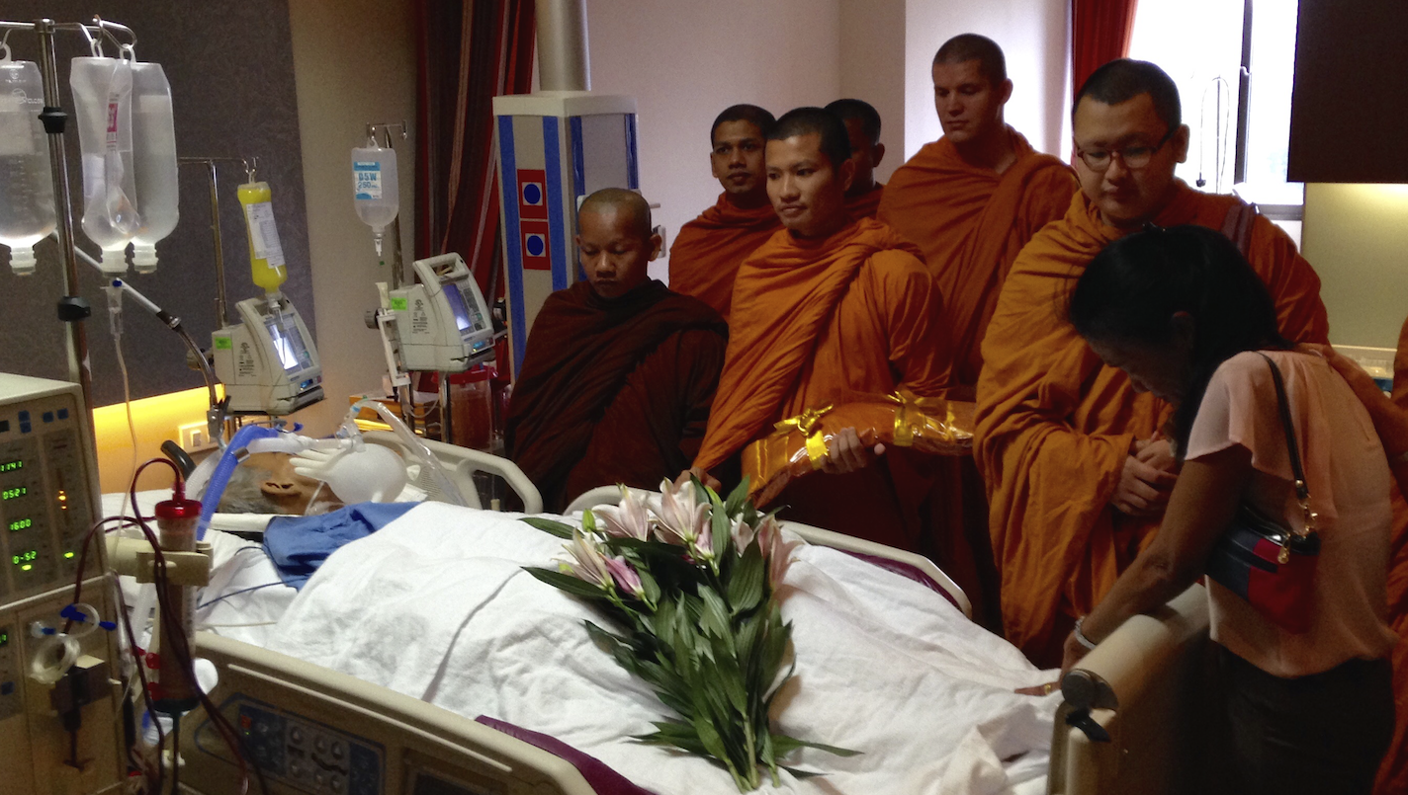
Notes:
RIP

Slide 20
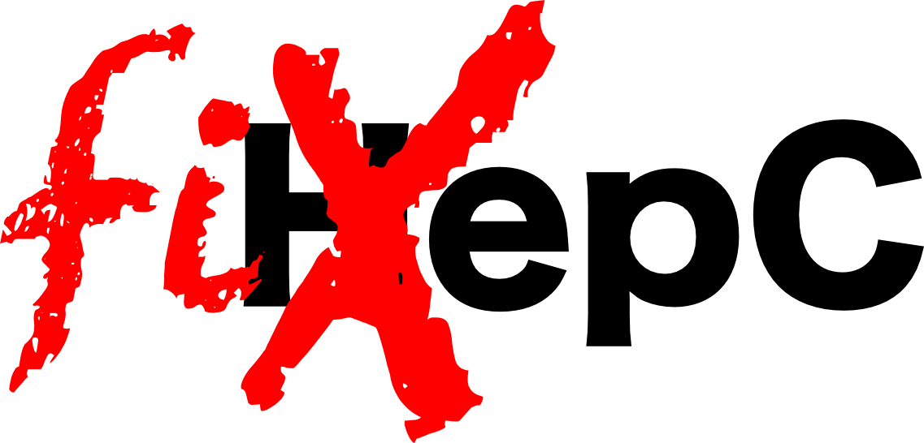
Notes:
In the time it took to give this presentation another 15 of our fellow citizens perished from a disease we have the power to cure.
We have the power to FixHepC.
My question to you, the audience, is do we have the will power? The will power to think global, but act local, and see cure deployed on a mass scale?
….Or would we rather blindly protect patent rights at the expense of patient lives?
Generics work. Let’s deploy them and wipe Hepatitis C off the face of the planet like we’ve done with smallpox and polio.

Slide 21
更多资讯
http://fixhepc.com
https://gp2u.com.au
https://clinicaltrials.gov/ct2/show/NCT02657694
HCV Decision Support Tool with expected SVR https://gp2u.com.au/hcv（帮助病人选择丙肝药物与推测治愈率的工具）
Notes:
Questions?

