Slide 1
복제 경구용 제제을 활용한 C형 간염 치료에서 높은 수준의 지속적 바이러스 반응
REDEMPTION-1(필자주: 이 임상연구의 이름)
James Freeman¹, Richard Sallie², Adam Kennedy³, Pham Thi Ngoc Nieu¹, John Freeman⁴, Greg Jeffreys⁵, Andrew M. Hill⁶
¹GP2U Telehealth, Hobart, ²Hepatology, Nedlands, ³Kingswood Pharmacy, ⁴Nephrology, Sandy Bay, ⁵University of Tasmania, Hobart, Australia, ⁶St Stephens AIDS Trust, Chelsea and Westminster Hospital, London, United Kingdom
International Liver Congress 2016 13-18 April, Barcelona, Spain
LB03
Notes:
REDEMPTION-1 is an ongoing open label study assessing the safety and effectiveness of generic direct acting antiviral Hepatitis C medication. This is an interim analysis of all the results to date.

Slide 2
세계적인 재앙
부작용이 거의 없고 완치율이 95% 이상인 경구용 제제가 연구개발되어 시장에 나오게 되었음
에이즈, B형간염, 결핵, 말라리아와 함께 C형 간염은 세계 5대 감염병에 해당함
안타깝게도 현재 이 치료 방법은 잘 이용되지 않음:
전세계적으로 약 1억 5천만 명의 C형 간염 환자가 있으며 ¹,
매년 50만 명이 C형 간염 때문에 사망하고 있음에도¹,
매년 50만 명 정도만 경구용 제제를 활용하여 치료 받고 있는 상황임^{2,3}
http://www.who.int/mediacentre/factsheets/fs164/en/
http://www.unitaid.eu/images/marketdynamics/publications/Hepatitis_C_Medicines_Technology_and_Market_Landscape__Update.pdf
http://www.bidnessetc.com/59228-gilead-sciences-inc-abbvie-inc-finally-see-growth-in-hcv-prescription-volum/
Notes:
Hepatitis C, Hepatitis B, HIV, TB and Malaria are the 5 major causes of infectious disease death worldwide.
In a breakthrough that rivals the invention of penicillin, drugs that cure hepatitis C, with minimal side effects and high success rates, have reached the market.
Across the world 150 million people are infected with Hepatitis C and it causes over ½ a million deaths each year, but, in what must be one of the greatest tragedies of modern times, these life saving medications are not being deployed on a mass scale.
It is sobering to reflect that more patients died last year than received the new treatments.

Slide 3
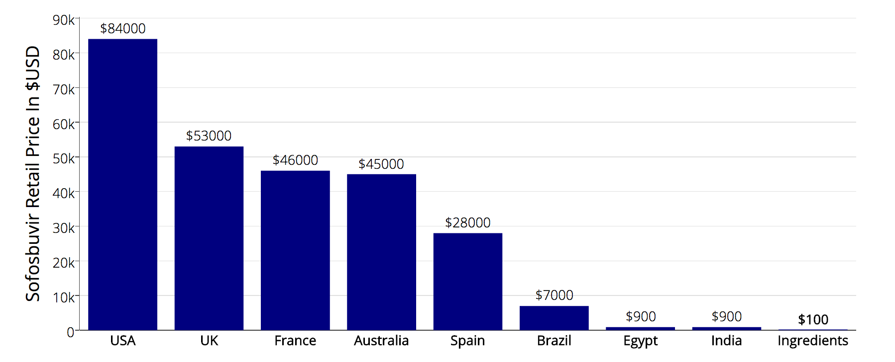
문제는 비싼 가격
Source: Significant reductions in costs of generic production of sofosbuvir and daclatasvir for treatment of hepatitis C, Hill et al, EASL 2016
Notes:
The deployment problem is price.
Although the ingredients for a 12 week course of Sovaldi cost less than $100, the US retail price is a staggering $84,000
To put that price in perspective if Apple put the same 100,000% markup on a new iPhone it would cost $1 million dollars.

Slide 4
배경
신약의 높은 가격은 환자들이 매우 효과적인 신약을 사용하는 것에 큰 문제가 되고 있음
소포스부비르, 레디파스비르, 다클라타스비르의 복제약은 미국 소매가 기준 1%의 가격으로 대량 생산될 수 있음¹
호주², 영국³, 그리고 많은 국가의 법령 하에서, 개인은 3개월 치의 약을 개인치료목적으로 수입할 권리가 있음.
Hill A. Minimum Costs for Producing Hepatitis C Direct-Acting Antivirals. Clin Inf Dis. 2014
https://www.tga.gov.au/personal-importation-scheme
https://www.gov.uk/government/organisations/hm-revenue-customs
Notes:
So the staggering prices of these new medications prevent patient access to safe and highly effective treatment.
But… Generic versions are being mass produced for under 1% of the current US retail price, in countries where the patents have been rejected.
And… Under the laws of Australia, the UK, and many other countries, individuals have the right to import a three month supply of medication, for their personal use

Slide 5
개인적 약품 수입의 법률적 근거
특허는 독점적 사용권을 보장함, 하지만…
TRIPS 협정 60조에 따르면:
협정국은 개인이 직접 반입 또는 택배를 통해 반입하는 비상업적 목적의 소량 수입에 대해 특허 조항의 적용을 배제할 수 있음
위 60조와 동일한 견지에서 대부분의 국가는 특저어 형태의 개인적 약품 수입을 허용하고 있음.
http://fixhepc.com/ 는 환자들로 하여금 약을 구입할 수 있게 도와주고, 환자들이 자신의 치료에 대해 의견을 교환할 수 있는 기회를 제공하고 있음
Notes:
Patents provision monopoly rights that are open to abuse, however other laws provision other rights.
Article 60 of the World Trade Organization TRIPS agreement makes small consignments exempt, and in line with Article 60 most countries allow some form of personal medication importation.
The fixhepc website was set up to help patients safely access generic medication and the forum there has over 1000 patients discussing their generic treatment experiences in real time.

Slide 6
방법
복제 경구약에 대해 먼저 HPLC, NMR and Mass Spectrometry(필자주: 매우 정교한 실험 기구)를 활용하여 그 품질을 테스트 했음
수 많은 환자들이 fixhepc.com 을 통해 실험에 참여했고, 복제약을 합리적인 가격에 구입할 수 있도록 도움 받았음.
환자들은 치료 전, 치료 도중, 치료 이후에 상태를 gp2u.com.au 라는 원격치료 사이트를 통해 점검 받았음
이 분석의 목적은 환자들이 합법적으로 수입할 수 있는 복제약을 통한 치료가 안전한지 그리고 효과가 있는지 확인하는 것임
Notes:
When the first patient asked for help, stating he was going to import generics with or without me, I concluded I could improve his safety if the medications he sourced were shipped to me first for testing. The deal was if they passed testing he could take them, and if not they were going in the garbage. The medications tested correctly, the patient took them, and he’s now past SVR24 and cured.
That single patient might have been my only patient, but the news leaked and 1 became a dozen, who in turn became hundreds. Thus was born REDEMPTION.
Consecutive patients were enrolled and assessed pre-treatment, during treatment and then for SVR
The objective was to answer the two key clinical questions – do generics work? and are they safe?

Slide 7
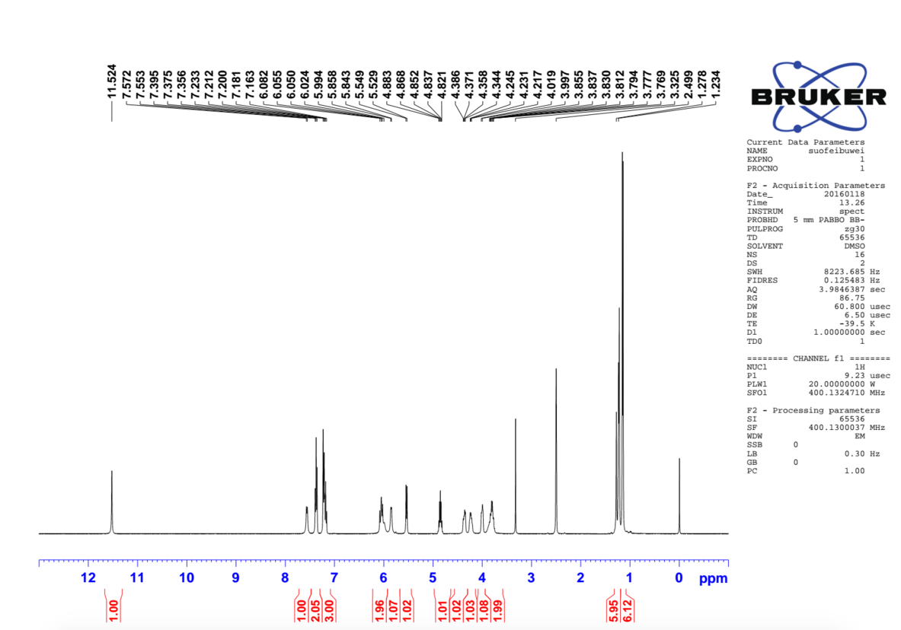
소포스부비르 NMR 성분 분석 결과
Notes:
For interest here is an NMR spectrum of some generic sofosbuvir. NMR is one of a range of techniques, such as High Performance Liquid Chromatography, Mass Spectrometry and X-ray crystallography that can establish the precise nature and purity of a medication.

Slide 8
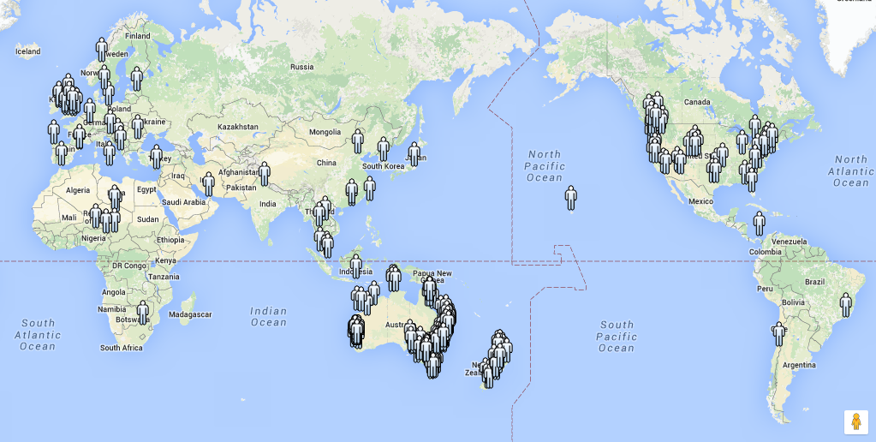
전 세계적으로 400명 이상의 환자들이 참여
Notes:
Although REDEMPTION is based in Australia the gp2u Telemedicine platform allowed patients from around the world to enroll

Slide 9
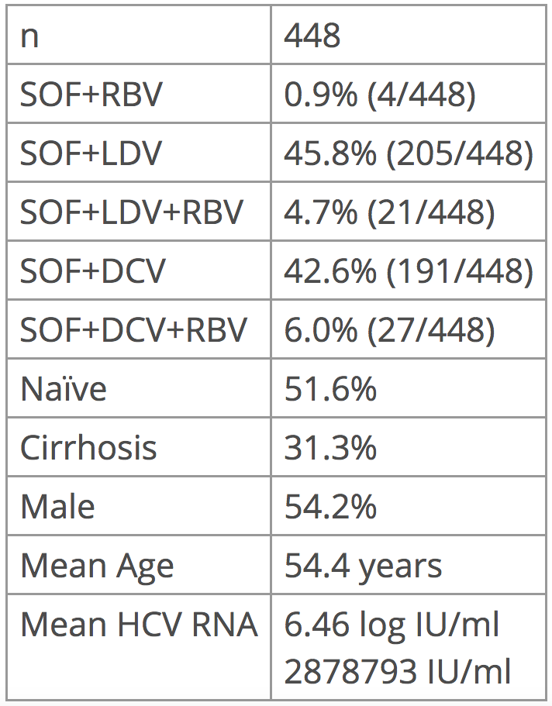
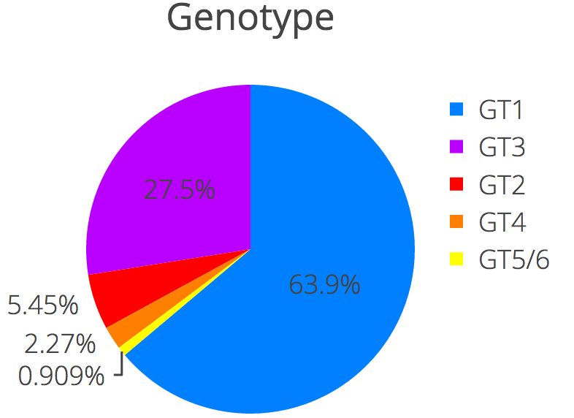
치료 시작 시점에서 환자들의 특징
Notes:
On the right you can see the genotype breakdown with the majority genotype 1, just under 1/3 genotype 3 with smaller percentages of the other genotypes.
448 patients enrolled.
There is a roughly 50:50 split between SOF+LDV and SOF+DCV with just over 10% also using ribavirin
This is a relatively unwell cohort with nearly 50% treatment experienced, over 30% cirrhotic, and a significant number who had previously been rejected from at least one clinical trial.
There was a slight male bias, an average age of 54 and a mean viral load of 2.8 million

Slide 10
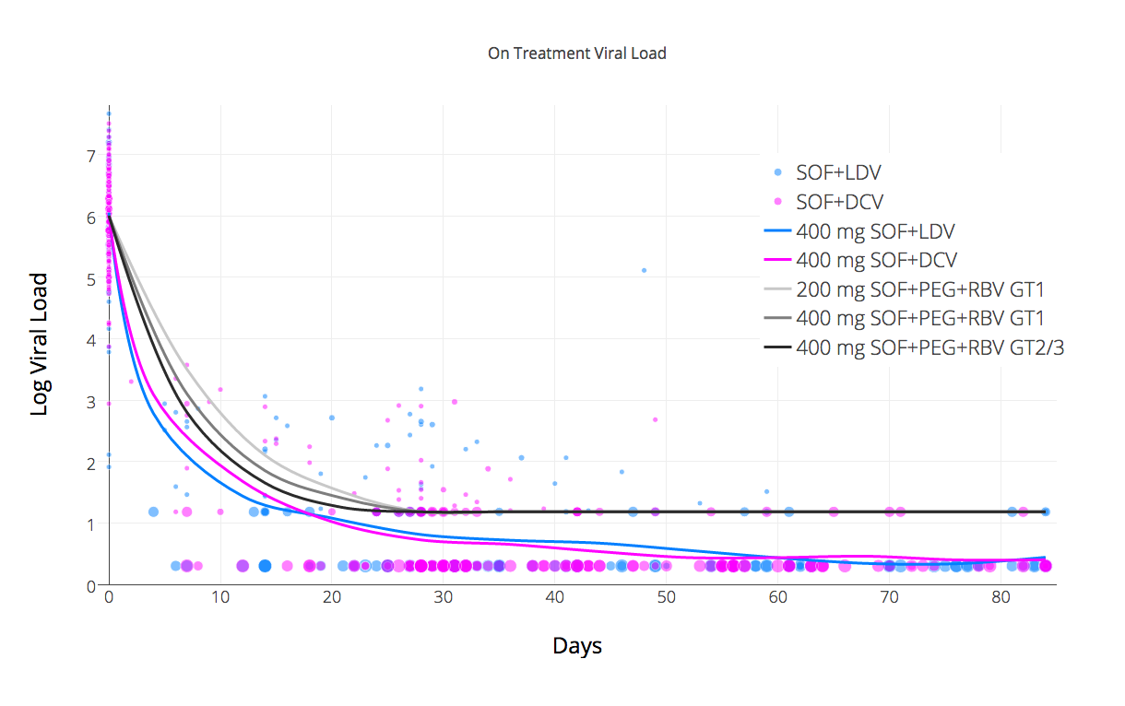
REDEMPTION-1의 바이러스 반응 vs 이미 알려진 연구들의 결과
SOF+PEG+RBV kinetics data source: http://www.thelancet.com/journals/laninf/article/PIIS1473-3099(13)70033-1/fulltext
Notes:
Let’s look at the on treatment viral kinetics The scatter plot dots are the viral load at various time points, and the size represents the log number of patients. Blue is Ledipasvir and Pink is Daclatasvir.
Unlike the usual reporting which stops at < LLOQ (<15) we have differentiated < LLOD as another data point and I think this makes evident a 2 stage kinetic decay – the first stage is rapid, but the second is substantially slower and it’s this slower second stage that dictates the minimum treatment duration.
The 3 grey lines are from data published in the Lancet in 2014 about the on treatment kinetics for SOF+PEG+RBV. As you can see the response for both the generic combinations used was substantially faster than this demonstrating the impact of effective NS5A inhibition. The difference between the SOF+LDV and SOF+DCV kinetics, where Daclatasvir looks slower, is an artifact due to it’s higher use in GT3 where the kinetics are slower than in GT1. If we look only at GT1 with SOF+DCV we see the response is slightly better that SOF+DCV and it crosses <LLOQ a little earlier.
There was one virological breakthrough.

Slide 11
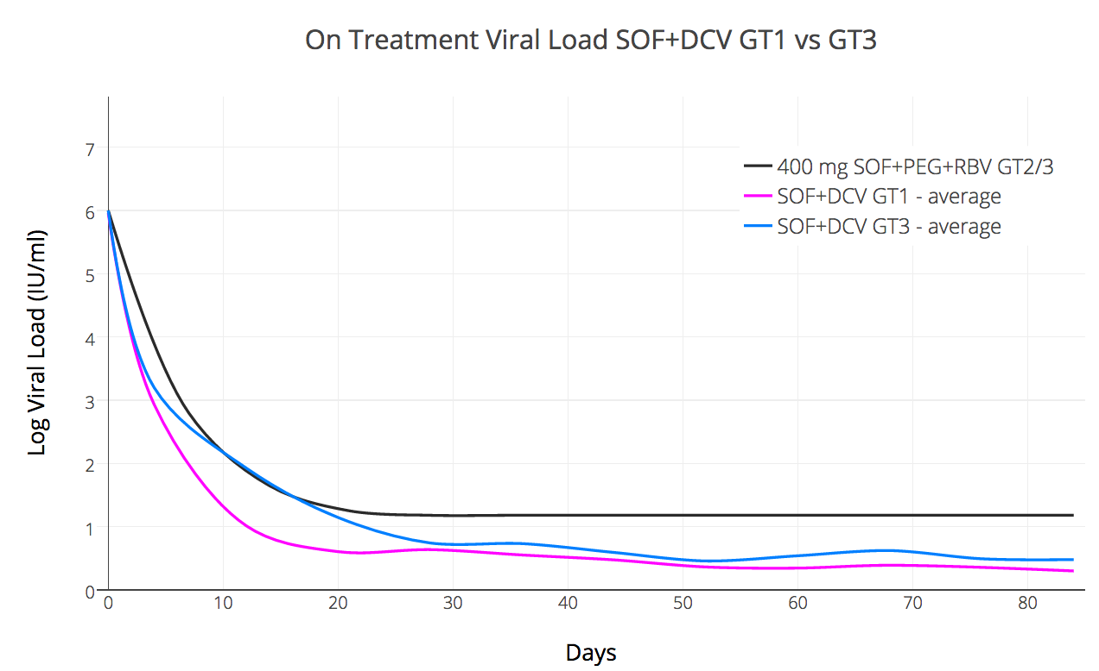
SOF+DCV치료의 바이러스 변화 GT1 vs GT3
Notes:
We used SOF+DCV in both GT1 and GT3 patients. We also differentiated <LLOQ (<15) and <LLOD (undetected)
What this allows us to see is that the kinetics in GT1 are prompt and essentially all patients are undetected by day 55 giving a notional 30 day over treat.
This is not the case with GT3 where the kinetics suggest 16 weeks treatment (or perhaps even longer) should really be the default minimum (or that for 12 weeks Ribavirin should be regarded as essential)

Slide 12
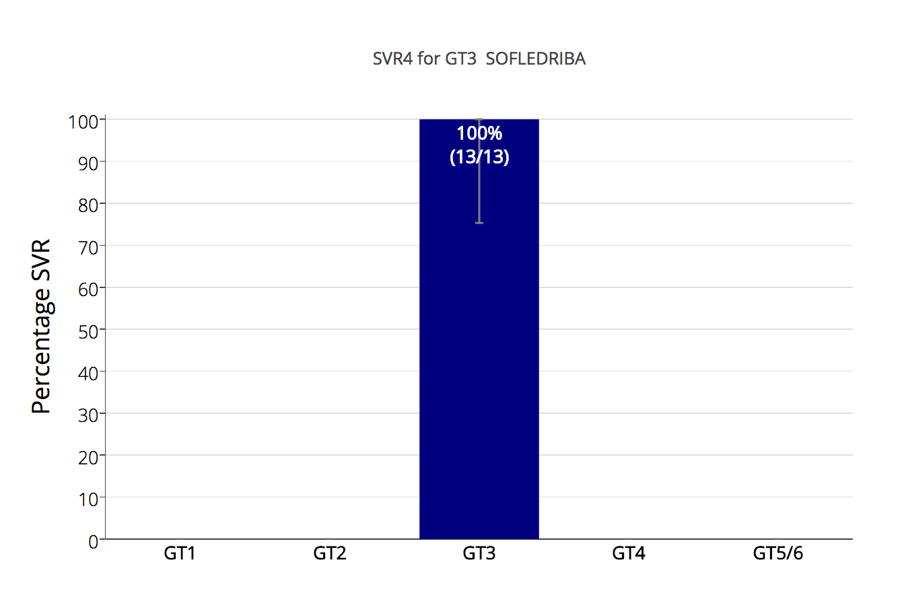
3형을 위한 SOF+LDV+RBV 치료? (Ed Gane 2015¹)
1) http://www.ncbi.nlm.nih.gov/pubmed/26261007
Notes:
So now to the first of the results.
In 2015 Professor Ed Gane published an interesting study about the use of SOF+LDV+/-RBV in GT3
One group – treatment naïve patients who also had RBV did very well with a 100% (26/26) SVR rate.
We’ve duplicated that result with generics suggesting it is repeatable and should perhaps be investigated at a larger scale.

Slide 13
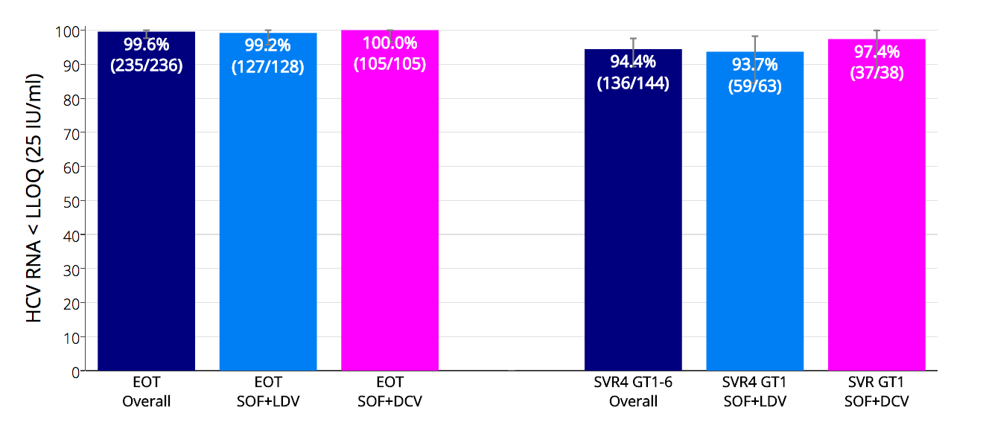
REDEMPTION-1의 치료종료 및 치료종료 후 4주 시점에서 바이러스 미검출 여부
Notes:
Here we can see that at the end of treatment 99.6% of patients were <LLOQ. One virological breakthrough reduced the result for LDV
The overall SVR4 rate was 94.4%.
Looking at GT1 only the results of LDV and DCV were similar, with the LDV result again suffering from that breakthrough patient (S282T RAV)

Slide 14
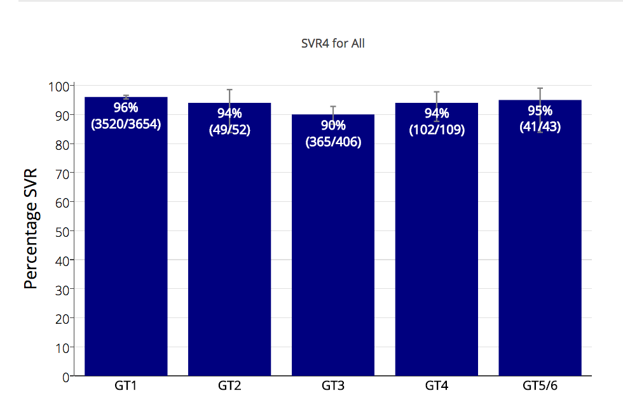
SOF+LDV와 SOF+DCV에 의한 치료의 기존 연구에서 SVR12 결과
Notes:
Dr Andrew Hill aggregated all the clinical trials data we could find for the DAA combinations SOF+LDV and SOF+DCV, and they are presented here.
And if we compare this to the results of generics….

Slide 15
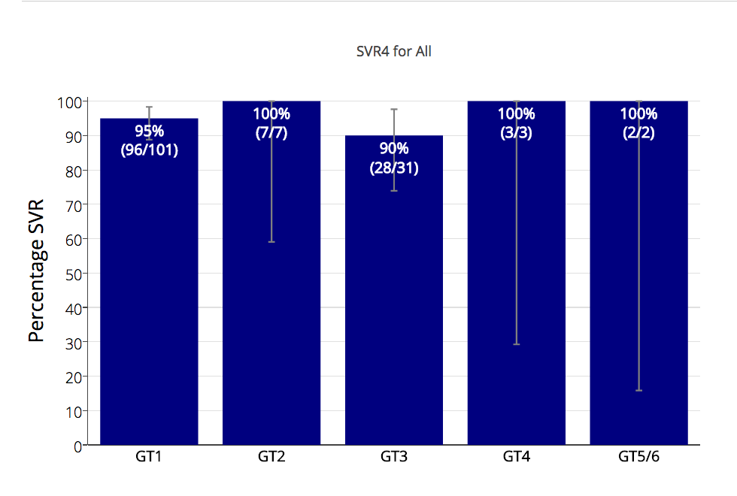
REDEMPTION-1 에서 복제약을 활용한 SVR4 결과
Note: Some small percentage loss of SVR is expected during the SVR4 to SVR12 period
Notes:
We don’t see a lot of difference.
The 100% results in GT2,4,5,6 are of course pretty meaningless given the tiny numbers, but for GT1 and GT3 the results are in line with expectations.
We do expect a handful of patients who passed SVR4 to fail SVR12 but don’t expect that to cause a huge change and note the confidence intervals are already reasonably narrow.

Slide 16
안전성
두통, 피료, 불면과 같은 이미 알려진 미미한 부작용을 제외하고는 새로운 부작용이 발견되지 않았음
대상성 간경변을 가진 3명의 환자는 치료 시작 직후 심장 부전이 왔으나 치료를 계속하였음
치료 도중에 등록한 4명의 환자가 간암으로 사망하였음
1명의 환자는 치료 시작 직전에 사망
2명의 환자는 치료 초기에 치료를 중단하고 말기 환자를 위한 치료경감 치료에 들어갔음
1명의 환자는 SVR4 도달 전에 사망하였음
Notes:
No new or unknown side effects were reported with headache, fatigue and insomnia being the most common
3 patients with compensated cirrhosis temporarily decompensated on treatment initiation but continued with treatment
4 patients who enrolled have since died, all from HCC

Slide 17
요약
이 중간 분석에 따르면, 합법적으로 수입할 수 있는 복제약으로 치료하는 것은 높은 수준의 효과를 보임
이 치료 결과(SVR)은 오리지널을 이용한 3상 임상실험의 결과와 유사함
복제약을 이용한 치료는 오리지널의 가격 때문에 치료가 어려운 환자들에게 효과적인 대안이 될 수 있음
Notes:
So in this interim analysis treatment with legally imported generic DAAs produced similar SVR rates to what we would expect from the clinical trials of their branded counterparts.
Doctors prescribing and monitoring patients taking generics can take comfort from the fact that, like the HIV generics that came before them, HCV generics deliver robust clinical results.

Slide 18
결론
C형 간염 복제약은 현재 미국 달러 기준 1000달러에 구입할 수 있으며, 오리지널과 동일한 효과를 보이고 있음
현재 치료 원료 가격과 생산 가격을 고려하면 SOF+DCV 치료는 환자당 200달러에 가능함. ¹
치료가 없다면 수 많은 환자들이 다음과 같은 모습이 놓일 것이 자명함…
Hill A. Minimum Costs for Producing Hepatitis C Direct-Acting Antivirals. Clin Inf Dis. 2014
Notes:
Generic cure for Hepatitis C is available now for $1000 and works as expected
Given current API pricing and production costs $200/patient treatment with SOF+DCV is possible, not in the future, but right now
It’s sad to reflect that at a price of $200/patient the entire world – all 150 million patients - could have been treated for less than the $31.5 billion dollars in profits made from the Sovaldi franchise in the last 3 years.
Without treatment the future for millions of patients infected with HCV looks like this…

Slide 19
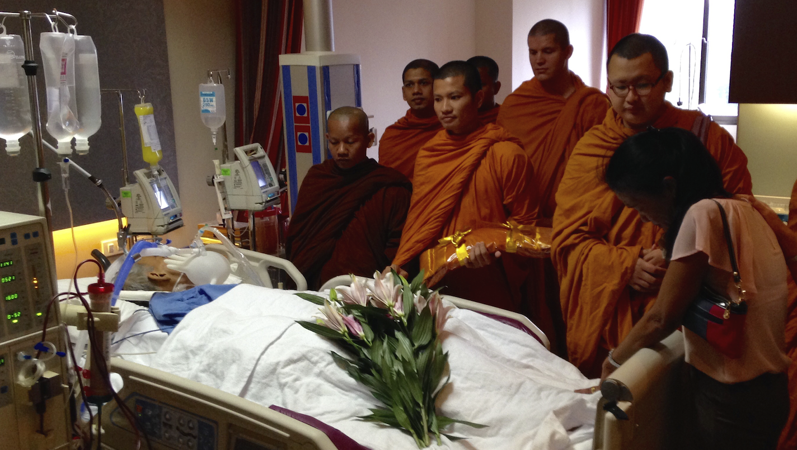
Notes:
RIP

Slide 20
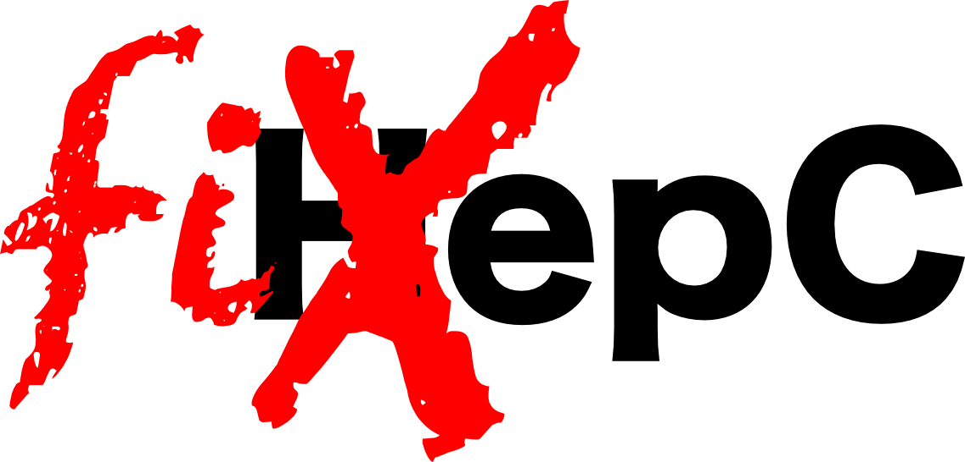
Notes:
In the time it took to give this presentation another 15 of our fellow citizens perished from a disease we have the power to cure.
We have the power to FixHepC.
My question to you, the audience, is do we have the will power? The will power to think global, but act local, and see cure deployed on a mass scale?
….Or would we rather blindly protect patent rights at the expense of patient lives?
Generics work. Let’s deploy them and wipe Hepatitis C off the face of the planet like we’ve done with smallpox and polio.

Slide 21
더 많은 정보
http://fixhepc.com
https://gp2u.com.au
https://clinicaltrials.gov/ct2/show/NCT02657694
HCV Decision Support Tool with expected SVR https://gp2u.com.au/hcv
Notes:
Questions?

