Slide 1
Integrating Immunotherapy Into the Treatment of Hepatocellular Carcinoma: A Multidisciplinary Perspective
This program is supported by an educational grant from Bristol-Myers Squibb.

Slide 2
Overview of Immunotherapy for Cancer
Osama E. Rahma, MD
Member of the Faculty of Medicine
Dana-Farber Cancer Institute
Harvard University
Boston, Massachusetts

Slide 3
About These Slides
Please feel free to use, update, and share some or all of these slides in your noncommercial presentations to colleagues or patients
When using our slides, please retain the source attribution:
These slides may not be published, posted online, or used in commercial presentations without permission. Please contact permissions@clinicaloptions.com for details
Slide credit: clinicaloptions.com
Notes:
Disclaimer: The materials published on the Clinical Care Options Web site reflect the views of the authors of the CCO material, not those of Clinical Care Options, LLC, the CME providers, or the companies providing educational grants. The materials may discuss uses and dosages for therapeutic products that have not been approved by the United States Food and Drug Administration. A qualified healthcare professional should be consulted before using any therapeutic product discussed. Readers should verify all information and data before treating patients or using any therapies described in these materials.

Slide 4
Faculty
Program Director:
Ghassan K. Abou-Alfa, MD Attending Physician Memorial Sloan Kettering Cancer Center
New York, New York
Osama E. Rahma, MD Member of the Faculty of Medicine
Dana-Farber Cancer Institute
Harvard University
Boston, Massachusetts
Tamar Taddei, MD Associate Professor of Medicine Division of Digestive Diseases Department of Medicine Yale University Director, Liver Cancer Programs Smilow Cancer Hospital Yale-New Haven Hospital New Haven, Connecticut
Andrew X. Zhu, MD, PhD, FACP Professor of Medicine
Harvard Medical School
Director, Liver Cancer Research
Massachusetts General Hospital Cancer Center
Boston, Massachusetts
Notes:
This slide lists the faculty who were involved in the production of these slides.

Slide 5
Faculty Disclosures
Ghassan K. Abou-Alfa, MD, has disclosed that he and/or his spouse have received consulting fees from Aduro, Agios, Array, Aslan, Astellas Pharma US, Bayer, Blueprint Medicines, Boston Scientific, Bristol-Myers Squibb, Celgene, CASI, Celsion, Delcath, Eisai, EMD Serono, Gilead Sciences, Halozyme, IntegraGen, Ipsen, Janssen, Merck, Merrimack, Momenta, New B Innovation, NewLink Genetics, Onxeo, Opsona, Pfizer, Roche, sanofi-aventis, Servier, Silenseed, Sillajen, Sirtex, Vaxxim, Vicus, and Westhaven and funds for research support from Amgen, AstraZeneca, Bayer, Bristol-Myers Squibb, CASI, Celgene, Chugai, Exelixis, Genentech, Incyte, Lilly, MabVax, MedImmune, Momenta, Myriad Genetics, OncoMed, Polaris, Roche, and Vicus.
Osama E. Rahma, MD, has no real or apparent conflicts of interest to report.
Tamar Taddei, MD, has disclosed that she has received consulting fees and funds for research support from Bayer.
Andrew X. Zhu, MD, PhD, FACP, has disclosed that he has received consulting fees from Bristol Myers-Squibb, Eisai, Merck, Nimbus, Novartis, Onkaido, sanofi-aventis and funds for research support from Lilly.
Notes:
This slide lists the disclosure information of the faculty and staff involved in the development of these slides.

Slide 6
Agenda
History of cancer immunotherapy
Tumor immunology
Evolution of immune checkpoint inhibition in solid tumors
Response kinetics of checkpoint blockade
Rationale for combination therapy

Slide 7
History of Cancer Immunotherapy

Slide 8
History of Cancer Immunotherapy: Key Milestones
IFN-α as adjuvant therapy for melanoma
Pembrolizumab and nivolumab approved for advanced melanoma
Atezolizumab approved for advanced UC and metastatic NSCLC
Discovery of dendritic cell
BCG approved for bladder cancer
Discovery of checkpoint inhibitors
Tumor-specific monoclonal Abs
Nivolumab approved for RCC
Nivolumab approved for HL
First immunotherapy approved for prostate cancer (sipuleucel-T)
Adoptive T-cell immunotherapy
1970s
1980s
1990s
2000s
2011
2014
2015
2016
Immune component
to spontaneous regressions in melanoma
IL-2 approved for RCC and melanoma (US)
Nivolumab approved for NSCLC
Pembrolizumab approved for
PD-L1+ NSCLC
Pembrolizumab approved for HNSCC
First checkpoint inhibitor (ipilimumab) approved for advanced melanoma
First tumor-associated antigen cloned (MAGE-1)
References in slidenotes.
Slide credit: clinicaloptions.com
Notes:
Ab, antibody; BCG, Bacillus Calmette-Guerin; HL, Hodgkin’s lymphoma; IFN, interferon; IL, interleukin; NSCLC, non-small-cell lung cancer; RCC, renal cell cancer; HNSCC, head and neck squamous cell carcinoma.
References
Steinman RM, et al. J Exp Med. 1973;137:1142-1162.
Kirkwood JM, et al. J Clin Oncol. 1996;14:7-17.
Fyfe G, et al. J Clin Oncol. 1995;13:688-696.
Atkins M. et al. J Clin Oncol. 1999;17:2105-2116.
Ishida Y, et al. EMBO J. 1992;11:3887-3895.
Nishimura H, et al. Immunity. 1999;11:141-151.
Freeman GJ, et al. J Exp Med. 2000;192:1027-1034.
Higano CS, et al. Cancer. 2009;115:3670-3679.
Hodi FS, et al. N Engl J Med. 2010;363:711-723.
Robert C, et al. Lancet. 2014;384:1109-1117.
Weber JS, et al. Lancet Oncol. 2015;16:375-384.
Rizvi N, et al. Lancet Oncol. 2015;16:257-265.
Borghaei H, et al. N Engl J Med. 2015;373:1627-1639.
Garon EB, et al. N Engl J Med. 2015;372:2018-2028.
Motzer RJ, et al. N Engl J Med. 2015;373:1803-1813.

Slide 9
Tumor Immunology

Slide 10
Immune System Function and Immune Response
Identify and destroy foreign or abnormal cells in the body
Innate Immunity
Adaptive Immunity
Nonspecific
First line of defense
WBCs (natural killer cells, neutrophils)
Activation of adaptive response
Specific
Adapts specifically to diverse stimuli
B-cell antibody production
T-cell stimulation
Memory functions
Dendritic cell
Mast cell
Macrophage
B-cell
λδ T-cell
T-cell
Natural killer cell
Basophil
Complement protein
Antibodies
Eosinophil
Natural killer T-cell
CD4+ T-cell
CD8+ T-cell
Granulocytes
Neutrophil
Immune surveillance:
Involves both innate and adaptive immune mechanisms
Goal of immunotherapy for cancer: to “educate and liberate” underlying anticancer immune responses
Janeway CA Jr, et al. Immunobiology: the immune system in health and disease. 2001.
Slide credit: clinicaloptions.com
Notes:
WBC, white blood cell.

Slide 11
Adaptive Immune System: T-Cells
4 main types of T-cells
Helper T-cells (CD4+)
Cytotoxic T-cells (CD8+)
Suppressor T-cells (CD4+ Foxp3+ CD25+ Tregs)
Memory T-cells (CD4+ or CD8+ CCR7+ CD45RO)
B-cell
T-cell
Antibodies
CD4+ T-cell
CD8+ T-cell
Slide credit: clinicaloptions.com
Notes:
Treg, regulatory T-cell.

Slide 12
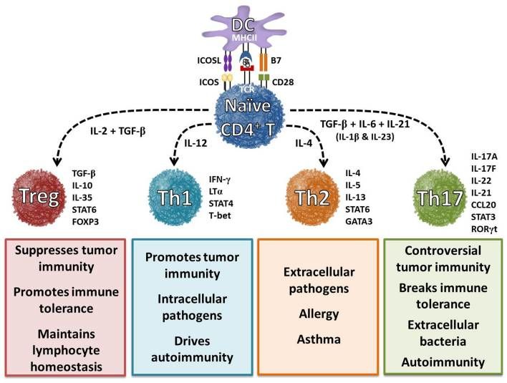
Cytokine-Driven Differentiation of CD4+ T-Cells
Bailey SR, et al. Front Immunol. 2014;5:276.
Slide credit: clinicaloptions.com
Notes:
IL, interleukin; TGF, transforming growth factor.

Slide 13
Tumor Immunology: Overview
3
Cytokines
Activated T-cell
Resting T-cell
TUMOR
2
LYMPH NODE
T-cell clonal expansion
Tumor antigen
1
Dendritic cell
Slide credit: clinicaloptions.com

Slide 14
T-Cell Response: First Signal
T-cell receptor
Class I MHC
Antigen-presenting cell
CD8+ T-cell
Tumor antigen
Class II MHC
T-cell receptor
Tumor
Tumor antigen
CD4+ T-cell
Adapted from: Snyder A, et al. Curr Opin Genet Dev. 2015;30:7-16.
Slide credit: clinicaloptions.com
Notes:
MHC, major histocompatibility complex.

Slide 15
Multiple Mechanisms of Immune Escape
Elimination (cancer immunosurveillance)
Equilibrium (cancer persistence/dormancy)
Escape (cancer progression)
CD8+ T-cell
CD8+ T-cell
NK
MΦ
CD8+ T-cell
IL-12
NKT cell
CD8+ T-cell
CTLA-4
TGF-β
IDO
IL-10
Galectin-1
NK
CD4+ T-cell
IFN-γ
PD-L1
CD4+ T-cell
CD4+ T-cell
MΦ
γδ T cell
CD8+ T cell
Genetic instability and immunoselection (ie, editing)
CD8+ T-cell
VEGF
M2
MΦ
CTLA-4
MDSC
Treg
Vesely MD, et al. Annu Rev Immunol. 2011;29:235-271.
Reproduced with permission of Annual Review of Immunology, Volume 29 © by Annual Reviews, http://www.annualreviews.org.
Chronic inflammation
Slide credit: clinicaloptions.com
Notes:
IFN, interferon; IL, interleukin; NK, natural killer; TGF, transforming growth factor; Treg, regulatory T-cell.

Slide 16
Evolution of Immune Checkpoint Inhibition in Solid Tumors

Slide 17
Stimulatory and Inhibitory Molecules During Immune Tumor Surveillance
Priming and activation CD28/B7.1 CD137/CD137L OX40/OX40L CD27/CD70 HVEM GITR IL-2 IL-12 CTLA-4/B7.1 PD-L1/PD-1 PD-L1/B7.1 prostaglandins
Stimulatory factors Inhibitors
4
Trafficking of T-cells to tumors CX3CL1 CXCL10 CXCL9 CCL5
3
Infiltration of T-cells into tumors LFA1/ICAM1 Selectins
VEGF Endothelin B receptor
5
Blood vessel
Lymph node
Cancer antigen presentation TNF-α IL-10
IL-1 IL-4 IFN-α IL-13
CD40L/CD40 CDN ATP HMGB1 TLR
Tumor
Recognition of cancer cells by T-cells T-cell receptor
Reduced pMHC on cancer cells
6
2
Killing of cancer cells IFN-γ T-cell granule content
PD-L1/PD-1 LAG-3 PD-L1/B7.1 Arginase IDO MICA/MICB TGF-β B7-H4
BTLA TIM-3/phospholipids VISTA
1
Release of cancer cell antigens Immunogenic cell death
Tolerogenic cell death
7
Chen DS, et al. Immunity. 2013;39:1-10.
Slide credit: clinicaloptions.com
Notes:
IL, interleukin; TGF, transforming growth factor; TNF, tumor necrosis factor.

Slide 18
T-Cell Regulation via Multiple Costimulatory and Inhibitory Interactions
Antigen-Presenting Cell
T-Cell
T-cell response to antigen is mediated by peptide-MHCs recognized specifically by TCR (first signal)
B7 family of membrane-bound ligands binds both activating and inhibitory receptors (second costimulatory signal)
Targeting CTLA-4 and PD-1 inhibitory receptors has been a major clinical focus
PD-L2
?
+
PD-L1
PD-1
-
CD80 or CD86
CD28
+
CD80 or CD86
CTLA-4
-
B7RP1
ICOS
+
B7-H3
?
-
B7-H4
?
-
HVEM
BTLA
-
Peptide
KIR
-
MHC class I or II
TCR
Signal 1
LAG3
-
CD137L
CD137
+
OX40L
OX40
+
CD70
CD27
+
CD40
CD40L
+
GAL9
TIM3
-
Adenosine
A2aR
-
Cytokines (TGF-β, IL-1, IL-6, IL10, IL-12, IL-18)
Pardoll DM. Nat Rev Cancer. 2012;12:252-264.
Slide credit: clinicaloptions.com
Notes:
MHC, major histocompatibility complex; TCR, T-cell receptor.

Slide 19
T-Cell Response: Accelerate or Brake?
Activating Signals
Inhibitory Signals
CD28
OX40
CTLA-4
GITR
T cell
PD-1
CD137
TIM-3
CD27
BTLA
HVEM
VISTA
LAG-3
T-Cell Stimulation
T-Cell Inhibition
Mellman I, et al. Nature. 2011;480:480-489.
Slide credit: clinicaloptions.com

Slide 20
Suppressive Immune Cells
Migration
PD-L1
Tumor
Cytotoxic
T-cell
Chemokines
Anergy
T
T
T
Treg
MDSC
IDO
Gajewski TF, et al. Curr Opin Immunol. 2011;23:286-292. Spranger S, et al. J Immunother Cancer. 2013;1:16.
Slide credit: clinicaloptions.com
Notes:
MDSC, myeloid-derived suppressor cells; Treg, regulatory T-cell.

Slide 21
General Approaches for Cancer Immunotherapy
Immune agonists
Peptide vaccine
DC vaccine
Genetic vaccine
CD40
CD137
IL-2
IFN
IL-15
IL-21
OX40
Immune checkpoint
inhibitors
CTLA-4
Active immunotherapy
Adoptive cell transfer
immunotherapy
PD-1
TCR or CAR
genetic engineering
T-cell cloning
Slide credit: clinicaloptions.com
Notes:
CAR, chimeric antigen receptor; DC, dendritic cell; IFN, interferon; IL, interleukin; TCR, T-cell receptor.

Slide 22
Ipilimumab Prolongs Survival in Metastatic Melanoma
Characteristic | Ipilimumab + gp100 (n = 403) | Ipilimumab Alone (n = 137) | gp100 Alone (n = 136)
Median OS, mos | 10 | 10.1 | 6.4
HR vs gp100 alone | 0.68 | 0.66 | --
P value | < .001 | .003 | --
First randomized, controlled phase III study to show improved OS for ipilimumab in pts with metastatic melanoma
Hodi FS, et al. N Engl J Med. 2010;363:711-723.
Slide credit: clinicaloptions.com

Slide 23
Response Rates With Anti–PD-1 Antibodies
Nivolumab^{[1]}
Pembrolizumab^{[2]}
100
First occurrence of new lesion
Pt off study
160
80
140
Prior ipilimumab treatment
No prior ipilimumab treatment
60
120
40
100
20
80
60
0
40
Change in Target Lesions From Baseline (%)
Change in Target Lesions From Baseline (%)
-20
20
0
-40
-20
-60
-40
-80
-60
-80
-100
-100
0
10
20
30
40
50
60
70
80
90
100
110
120
130
140
Individual Pts Treated With Pembrolizumab
Wks Since Treatment Initiation
ORR
Melanoma: 28%
NSCLC: 18%
Renal cell cancer: 27%
Confirmed ORR
Melanoma: 38% (comparable ± previous ipilimumab)
1. Topalian SL, et al. N Engl J Med. 2012;366:2443-2454.
2. Hamid O, et al. N Engl J Med. 2013;369:134-144.
Slide credit: clinicaloptions.com
Notes:
NSCLC, non-small-cell lung cancer.

Slide 24
The Expansion of Immunotherapy
PD-1 Inhibition
NSCLC
CRC
**
Atezolizumab
RCC
Pembrolizumab
*
Urothelial
*
HCC
Durvalumab + Tremelimumab
Gastric
Durvalumab + Tremelimumab
Anal
Durvalumab
NSCLC, Squamous
Nivolumab
HNSCC
Nivolumab
*
NSCLC, all
Pembrolizumab
PD-L1+
NSCLC, Nonsquamous
Atezolizumab
Breast
Avelumab
PD-L1-
0
10
20
30
40
50
Durvalumab
Pembrolizumab
PD-L1 Inhibition
Pembrolizumab
0
10
20
30
40
50
Urothelial
Nivolumab
Urothelial
Breast
Atezolizumab
NSCLC
Avelumab
Atezolizumab
NSCLC
Atezolizumab
NSCLC
Durvalumab
Pembrolizumab
NSCLC
Atezolizumab +
platinum doublet
0
10
20
30
40
50
Pancreatic
0
10
20
30
40
50
60
Durvalumab +
tremelimumab
Other
Combination Therapy
Breast (Atezolizumab)
NSCLC
Pembrolizumab +
ipilimumab
Gastric (Pembrolizumab)
NSCLC
HNSCC (Pembrolizumab)
NSCLC
Nivolumab +
ipilimumab
RCC
Breast (pembrolizumab)
SCLC
0
10
20
30
40
0
20
40
60
80
ORR
ORR
Gentzler R, et al. Immunotherapy. 2016;8:583-600.
Slide credit: clinicaloptions.com
Notes:
CRC, colorectal cancer; RCC, renal cell carcinoma; HCC, hepatocellular carcinoma; NSCLC, non-small-cell lung cancer; HNSCC, head and neck squamous cell carcinoma; SCLC, small-cell lung cancer.

Slide 25
Durvalumab: Antitumor Activity in Multiple Solid Tumors
All pts, all doses; N = 367
NSCLC Nonsquamous
NSCLC Squamous
Melanoma, Cutaneous
Melanoma, Uveal
CRC RCC HCC
HNSCC
On treatment
Gastroesophageal
TNBC
Pancreatic Adeno
0
6
12
18
24
30
36
42
48
54
60
Wks Since Treatment Initiation
Segal NH, et al. ASCO 2014. Abstract 3002.
Slide credit: clinicaloptions.com
Notes:
HCC, hepatocellular carcinoma; HNSCC, head and neck squamous cell carcinoma; NSCLC, non-small-cell lung cancer; RCC, renal cell carcinoma; TNBC, triple-negative breast cancer.

Slide 26
Case
A 61-yr-old man with multifocal HCC with metastases to hilar and retroperitoneal lymph nodes has enrolled on a clinical trial of pembrolizumab after failure of sorafenib
After 9 wks of treatment, he continues to have ECOG PS 0, no symptoms related to cancer, and no significant treatment-related toxicity
However, recent scans show multiple lymph nodes have increased in size by 5-10 mm each throughout the retroperitoneum and some liver lesions have either increased slightly while others have remained stable
Slide credit: clinicaloptions.com
Notes:
ECOG, Eastern Cooperative Oncology Group; HCC, hepatocellular carcinoma; PS, performance status.

Slide 27
Response Kinetics of Checkpoint Blockade

Slide 28
CTLA-4–Delayed Response Kinetics
Treated with 3 mg/kg ipilimumab Q3W x 4
Wolchok J, et al. ASCO 2008. Abstract 3020.
Slide credit: clinicaloptions.com

Slide 29
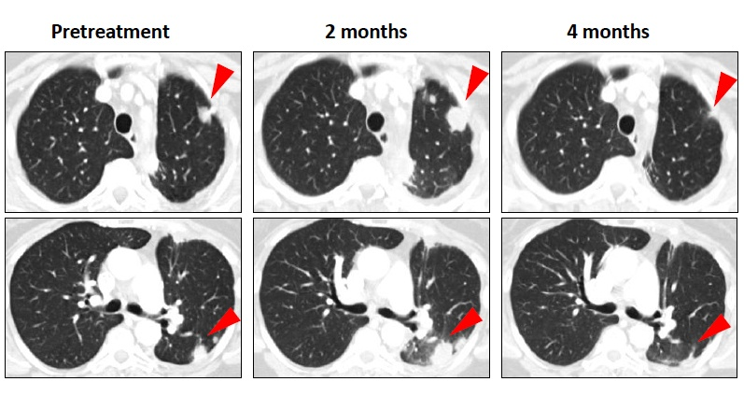
Nivolumab (10 mg/kg): Response of Metastatic NSCLC
Initial progression in pulmonary lesions of a NSCLC pt with nonsquamous histology followed by regression
Topalian SL, et al. N Engl J Med. 2012;366:2443-2454.
Slide credit: clinicaloptions.com
Notes:
NSCLC, non-small-cell lung cancer.

Slide 30
WHO vs Immune-Related Response Criteria
Criterion | WHO | irRC
New, measurable lesions (ie, ≥ 5 x 5 mm) | Always represent PD | Incorporated into tumor burden
New, nonmeasurable lesions (ie, < 5 x 5 mm) | Always represent PD | Do not define progression (but preclude irCR)
PR | ≥ 50% decrease in SPD of all index lesions compared with BL in 2 observations at least 4 wks apart, in absence of new lesions or unequivocal progression of nonindex lesions | ≥ 50% decrease in tumor burden compared with BL in 2 observations at least 4 wks apart
PD | ≥ 25% increase in SPD compared with nadir and/or unequivocal progression of nonindex lesions and/or appearance of new lesions (at any single time point) | ≥ 25% increase in tumor burden compared with nadir (at any single time point) in 2 consecutive observations at least 4 wks apart
Wolchock JD, et al. Clin Cancer Res. 2009;15:7412-7420.
Slide credit: clinicaloptions.com
Notes:
BL, baseline; irCR, immune-related CR; irRC, immune-related response criteria; SPD, sum of the product of the diameters; WHO, World Health Organization.

Slide 31
PD-1 Blockade Characterized by More Rapid Response Kinetics
100
80
60
Pembrolizumab (n = 279)^{[1]}
ORR: 33.7%
Median OS: NR
40
20
0
-20
-40
-60
-80
-100
Maximum Change From BL (%)
100
Nivolumab (n = 210)^{[2]}
ORR: 40%
8.1% delayed response
Median OS: NR
80
60
40
20
0
-20
-40
-60
-80
-100
Pts
1. Robert C, et al. N Engl J Med. 2015;372:2521-2532.
2. Robert C, et al. N Engl J Med. 2015;372:320-330.
Slide credit: clinicaloptions.com
Notes:
BL, baseline; NR, not reached.

Slide 32
Durable Responses in Phase II Studies
Nivolumab^{[1]}
Pembrolizumab^{[2]}
PD or could not be determined
Pts still on treatment
Mismatch repair–proficient colorectal cancer
Mismatch repair–deficient colorectal cancer
Mismatch repair–deficient noncolorectal cancer
First new lesion
PR
SD
Advanced, refractory squamous NSCLC (N = 117)
ORR: 14.5%
Median time to response: 3.3 mos
Median DoR: NR
Progressive metastatic carcinoma ± mismatch repair deficiency (N = 41)
ORR: 40% for MSI high CRC, 0% for MSS CRC
Median PFS and OS: NR for MSI high CRC
100
200
75
50
100
25
Change in Tumor Marker
Level (%)
Change in Target Lesions
From Baseline (%)
0
-25
0
0% (no change)
-50
-75
-100
-100
0
6
12
18
24
30
36
42
48
54
60
66
0
100
200
300
400
Wks Since Start of Treatment
Days
1. Rizvi NA, et al. Lancet Oncol. 2015;16:257-265.
2. Le DT, et al. N Engl J Med. 2015;372:2509-2520.
Slide credit: clinicaloptions.com
Notes:
CRC, colorectal cancer; DoR, duration of response; MSI, microsatellite instability; MSS, microsatellite stable; NR, not reported; NSCLC, non-small-cell lung cancer; PD, progressive disease; SD, stable disease.

Slide 33
Ipilimumab: Phase II/III Pooled Survival Analysis in Advanced Melanoma
1.0
0.8
Median OS: 11.4 mos (95% CI: 10.7-12.1)
0.6
3-yr OS rate: 22% (95% CI: 20% to 24%)
Proportion Alive
0.4
0.2
Ipilimumab
0
Censored
0
12
24
36
48
60
72
84
96
108
120
Pts at Risk, n
Mos
Ipilimumab
1861
839
370
254
192
170
120
26
15
5
0
Schadendorf D, et al. J Clin Oncol. 2015;33:1889-1894.
Slide credit: clinicaloptions.com

Slide 34
Rationale for Combining Checkpoint Inhibitors

Slide 35
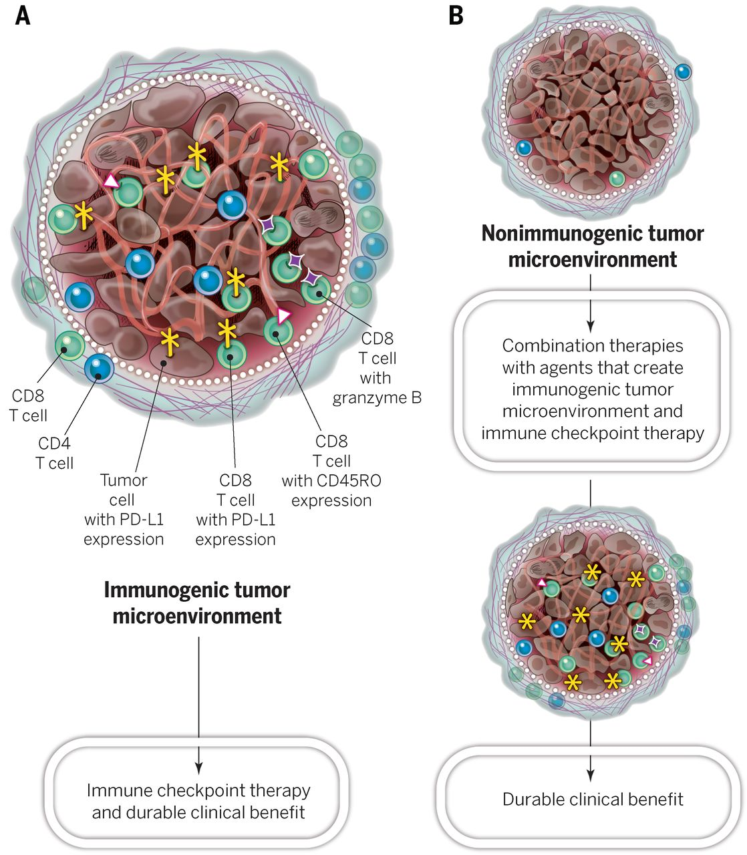
Rationale for Combination Immunotherapy
Sharma P, et al. Science. 2015;348:56-61.
Reprinted with permission from AAAS.
Slide credit: clinicaloptions.com

Slide 36
CheckMate 067: Nivolumab + Ipilimumab vs Monotherapy in Metastatic Melanoma
Nivolumab
Nivolumab + Ipilimumab
100
Median change: -34.5%
100
Median change: -51.9%
75
75
50
50
Best Change From Baseline in Target-Lesion Volume (%)
25
Best Change From Baseline in Target-Lesion Volume (%)
25
0
*
0
-25
*
-25
*
*
*
*
*
*
*
*
*
*
*
*
*
*
*
*
*
*
*
*
*
*
*
*
*
*
*
*
*
*
*
*
*
*
*
*
*
*
*
*
*
*
*
*
*
*
*
*
*
*
*
*
*
*
-50
*
*
*
*
*
-50
*
*
*
*
*
*
*
*
*
*
*
*
*
*
*
*
*
*
*
*
*
*
*
*
*
*
*
*
*
*
*
*
*
*
*
*
*
*
*
*
*
*
*
*
*
*
*
*
*
*
*
*
*
*
*
*
*
*
*
*
*
*
*
*
*
*
*
*
*
*
-75
*
*
*
*
*
*
*
*
-75
*
*
*
*
*
*
*
*
*
*
*
*
*
*
*
*
*
*
*
*
*
*
*
*
*
*
*
*
*
*
*
*
*
*
*
*
*
*
*
*
*
*
*
*
-100
*
*
*
*
*
*
*
*
*
*
*
*
*
*
*
*
*
*
*
*
*
*
*
*
*
*
*
-100
*
*
*
*
*
*
*
*
*
*
*
*
*
*
*
*
*
*
*
*
*
*
*
*
*
Pts
Pts
Ipilimumab
100
Median change: 5.9%
Treatment | ORR, % | Grade 3/4 TRAEs, %
Nivo | 43.7 | 16.3
Nivo + ipi | 57.6 | 55.0
Ipi | 19.0 | 27.3
75
50
Best Change From Baseline in Target-Lesion Volume (%)
25
0
*
-25
*
*
*
*
*
*
*
*
*
*
*
*
*
*
*
*
-50
*
*
*
*
*
*
*
*
*
*
*
*
*
*
*
*
-75
*
*
*
*
*
-100
*
*
*
*
*
*
*
*
Pts
Larkin J, et al. N Engl J Med. 2015;373:23-34.
Slide credit: clinicaloptions.com
Notes:
Ipi, ipilimumab; Nivo, nivolumab; TRAE, treatment-related adverse event.

Slide 37
Go Online for More CCO Coverage of HCC!
More downloadable slidesets on the mechanisms of action, efficacy, safety, and clinical integration of checkpoint inhibitors for HCC
On-demand Webcast from the live symposium
Algorithm Tool The Clinician’s Guide to Managing Immune-Related Adverse Events
clinicaloptions.com/oncology

